Slide 1
COMPUTER NETWORKS
Chapter 5 The Network Layer

Slide 2
The Network Layer
Responsible for delivering packets between endpoints over multiple links
Application
Transport
Network
Link
Physical

Slide 3
The Network Layer Chapter 5
Network Layer Design Issues
Routing Algorithms in a Single Network
Traffic Management at the Network Layer
Quality of Service and Application QoE
Internetworking
Software Defined Networking
The Network Layer in the Internet
Policy at the Network layer
Summary

Slide 4
Network Layer Design Issues
Store-and-forward packet switching
Services provided to the transport layer
Implementation of connectionless service
Implementation of connection-oriented service
Comparison of virtual-circuit and datagram networks

Slide 5
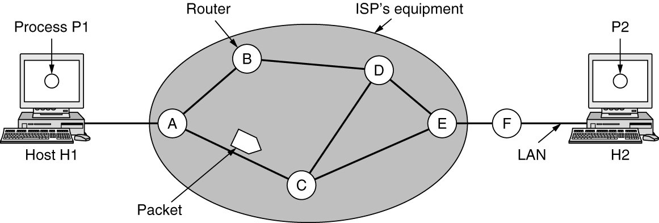
Store-and-Forward Packet Switching
A host with a packet to send transmits it to the nearest router. The packet is received, verified, and stored. Then it is forwarded to the next router. This step can be repeated many times. Finally the packet reaches the destination host.
Hosts send packets into the network; packets are forwarded by routers
Packetizing：encapsulating the payload in a network-layer packet at the source
and decapsulating the payload from the network-layer packet at the destination.
Routing and forwarding
The environment of the network layer protocols

Slide 6
Services Provided to the Transport Layer
Services independent of router technology
Transport layer shielded from number, type, topology of routers
Network addresses available to transport layer use uniform numbering plan
Even across LANs and WANs

Slide 7
Connectionless & connection-oriented service
Connectionless service
each packet is treated independently
the network layer is only responsible for delivery of packets from the source to the destination
the packets in a message may or may not travel the same path to their destination.
Connection-oriented service
Before all datagrams in a message can be sent, a virtual connection should be set up to define the path for the datagrams.
After connection setup, the datagrams can all follow the same path.
The packet contain the source and destination addresses, also a flow label, a virtual circuit identifier that defines the virtual path the packet should follow.

Slide 8
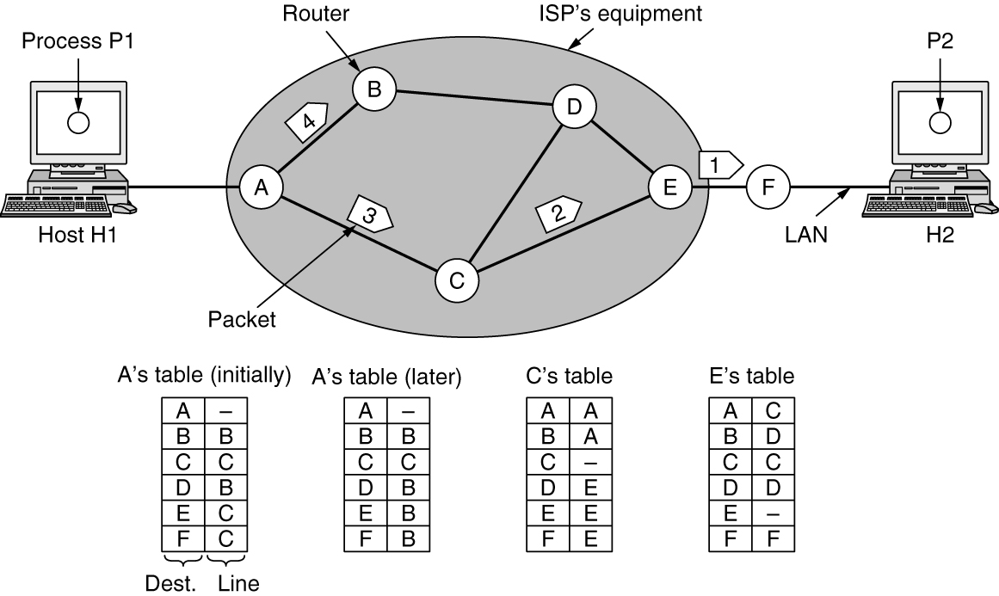
Implementation of Connectionless Service
Packet is forwarded using destination address inside it
Different packets may take different paths
Routing within a datagram network

Slide 9
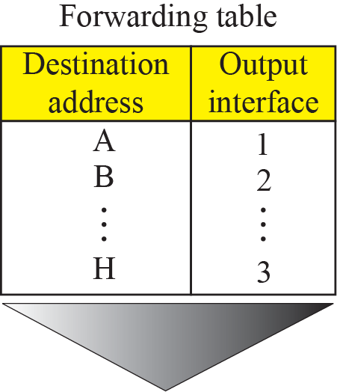
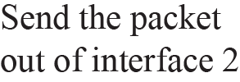
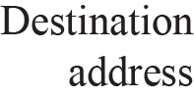
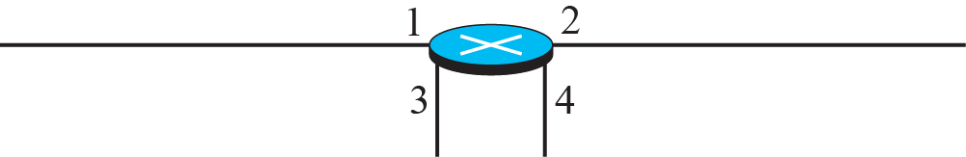
Forwarding process in a router when used in a connectionless network

Slide 10
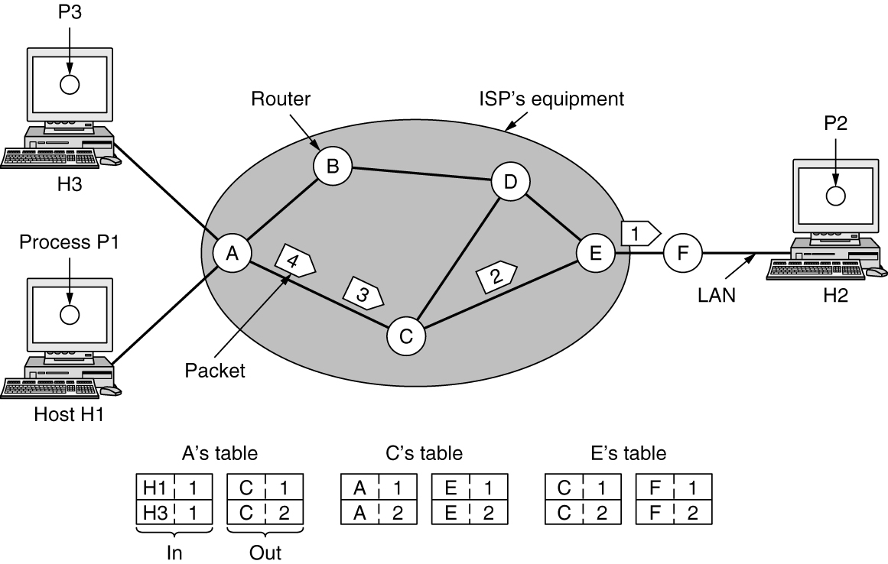
Implementation of Connection-Oriented Service
Packet is forwarded along a virtual circuit using tag inside it
Virtual circuit (VC) is set up ahead of time
Every router on source-dest path maintains “state” for each passing connection
Link, router resources (bandwidth, buffers) may be allocated to VC(dedicated resources = predictable service)
Routing within a virtual-circuit network

Slide 11
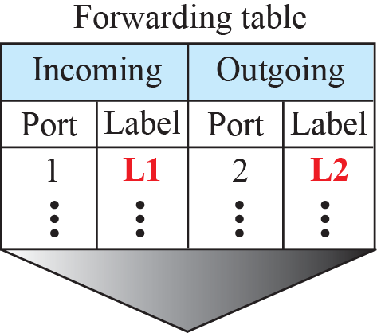


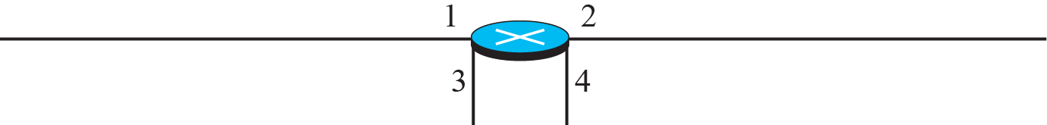
Forwarding process in a router when used in a virtual circuit network

Slide 12
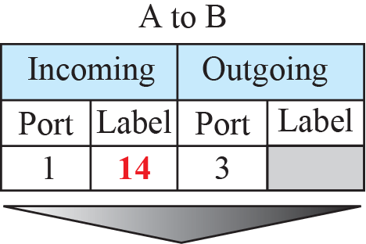
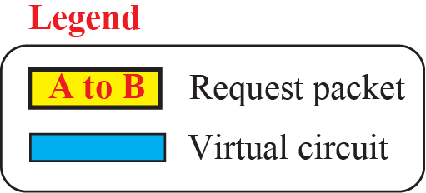
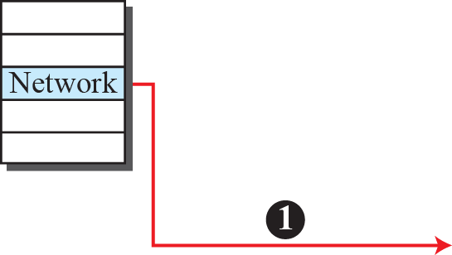
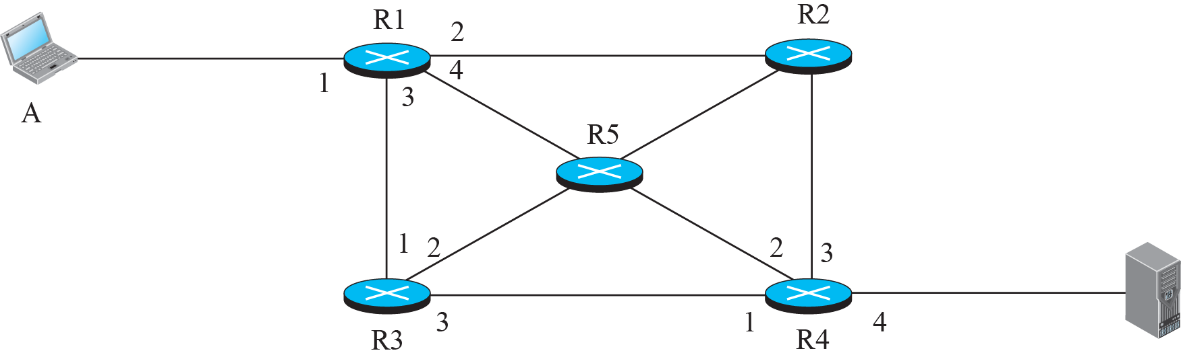
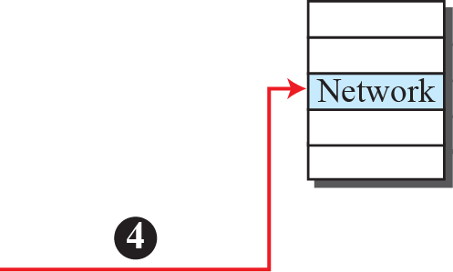

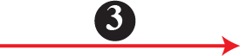
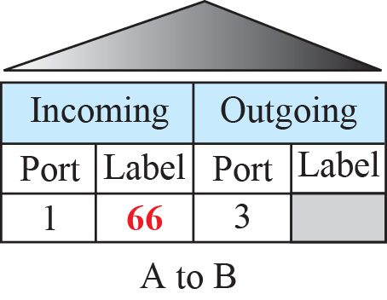
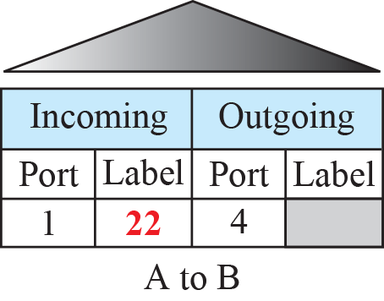
Sending request packet in a virtual-circuit network

Slide 13
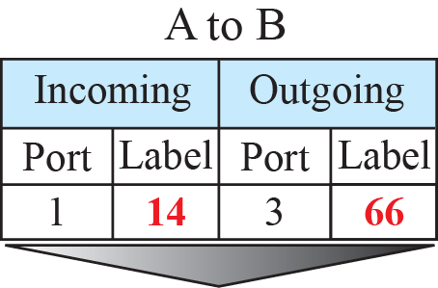
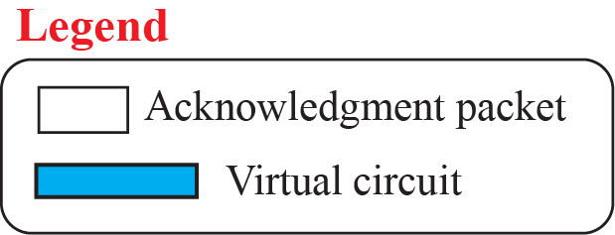
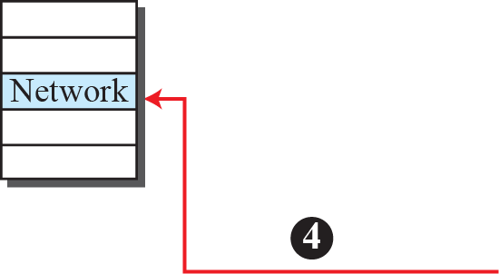
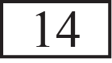
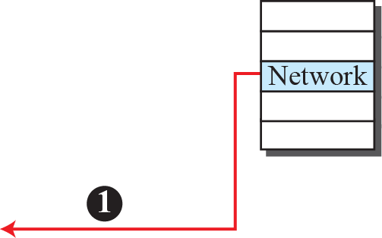



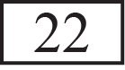

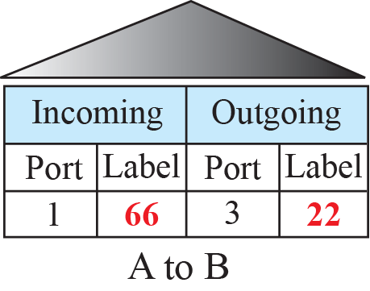
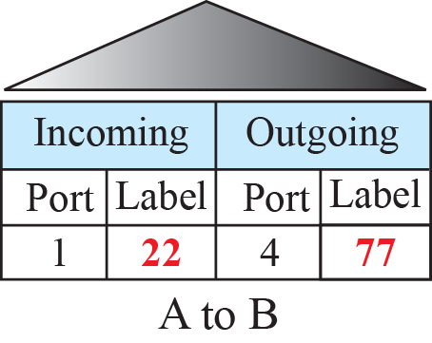
Sending acknowledgments in a virtual-circuit network

Slide 14
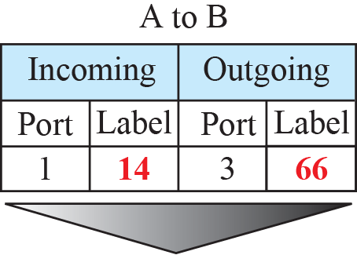
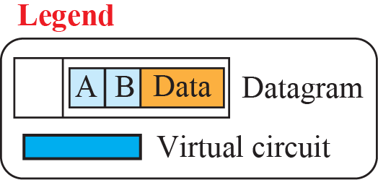
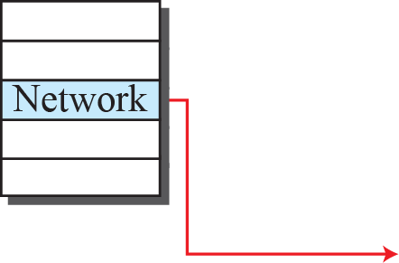

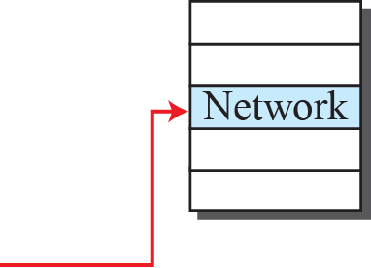



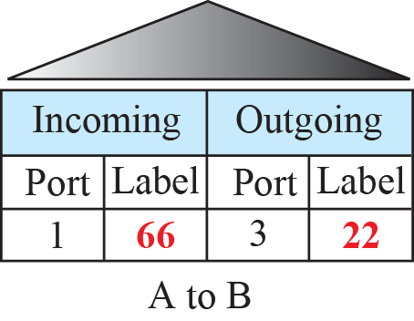
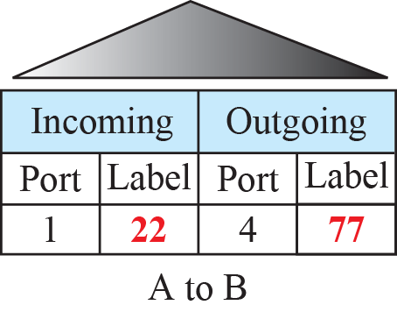
Flow of one packet in an established virtual circuit

Slide 15
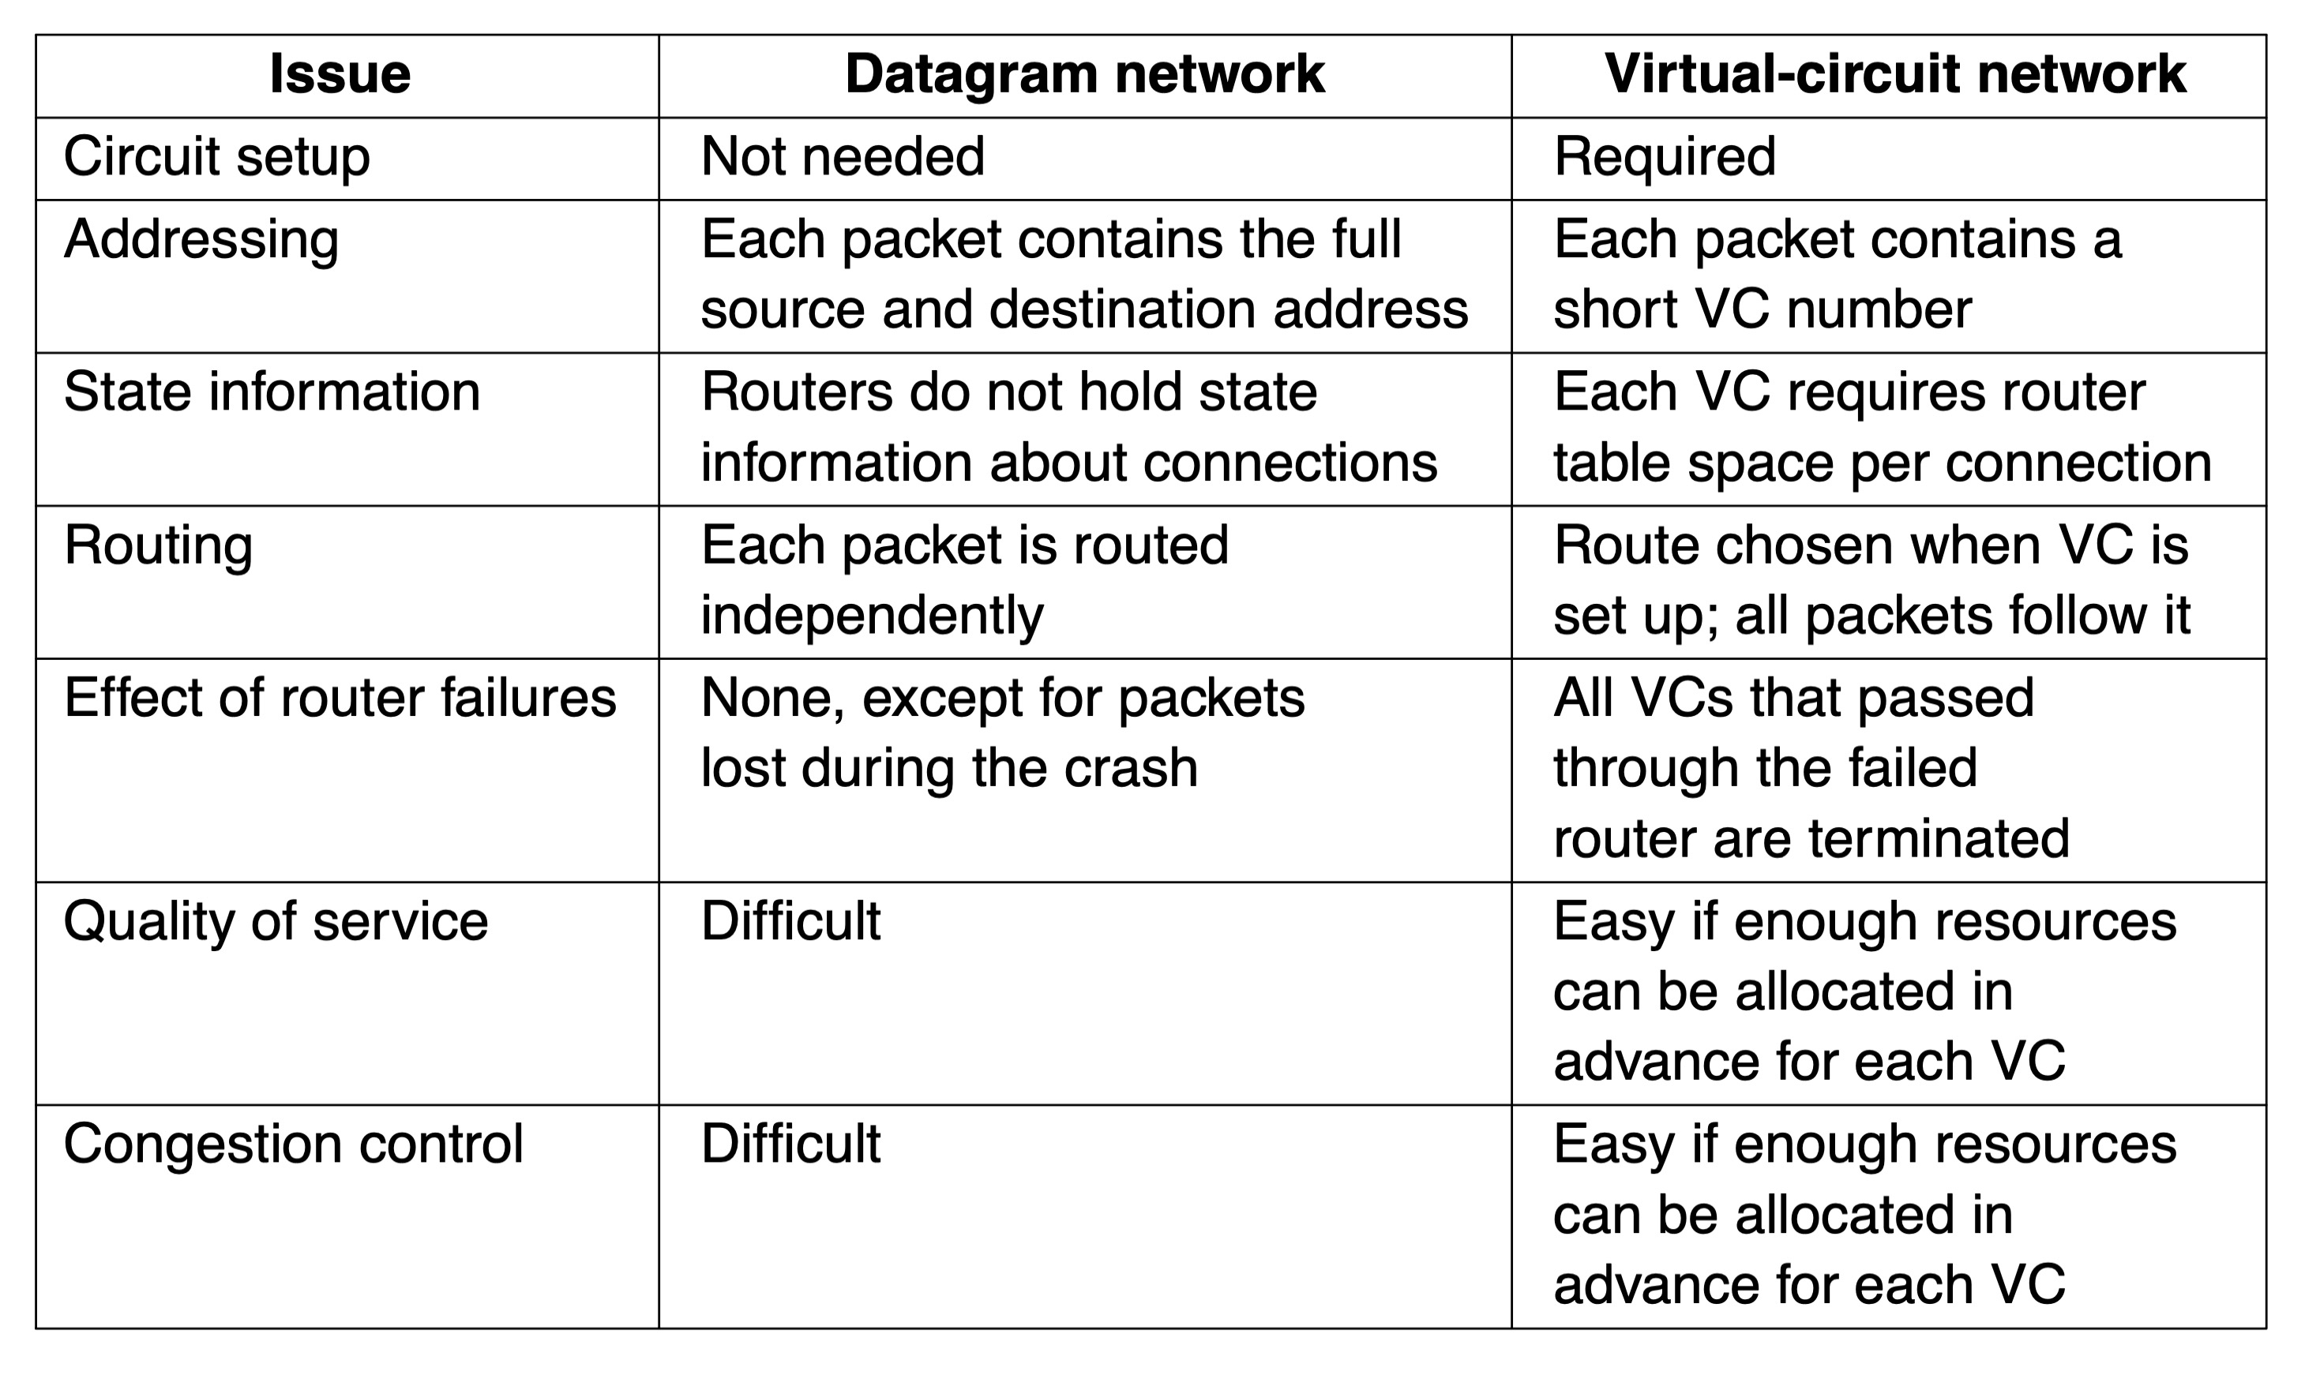
Comparison of Virtual-Circuit and Datagram Networks
Comparison of datagram and virtual-circuit networks

Slide 16
The Network Layer Chapter 5
Network Layer Design Issues
Routing Algorithms in a Single Network
Traffic Management at the Network Layer
Quality of Service and Application QoE
Internetworking
Software Defined Networking
The Network Layer in the Internet
Policy at the Network layer
Summary

Slide 17
Routing Algorithms in a Single Network
Optimality principle
Shortest path algorithm
Flooding
Distance vector routing
Link state routing
Hierarchical routing within a network
Broadcast routing
Multicast routing
Anycast routing

Slide 18

How to route in the Internet?
The Opte Project
The Internet 2003
https://www.opte.org/the-internet/
Notes:
强调因特网发展迅猛、规模巨大、动态变化、高度复杂

Slide 19

The Internet 2010

Slide 20
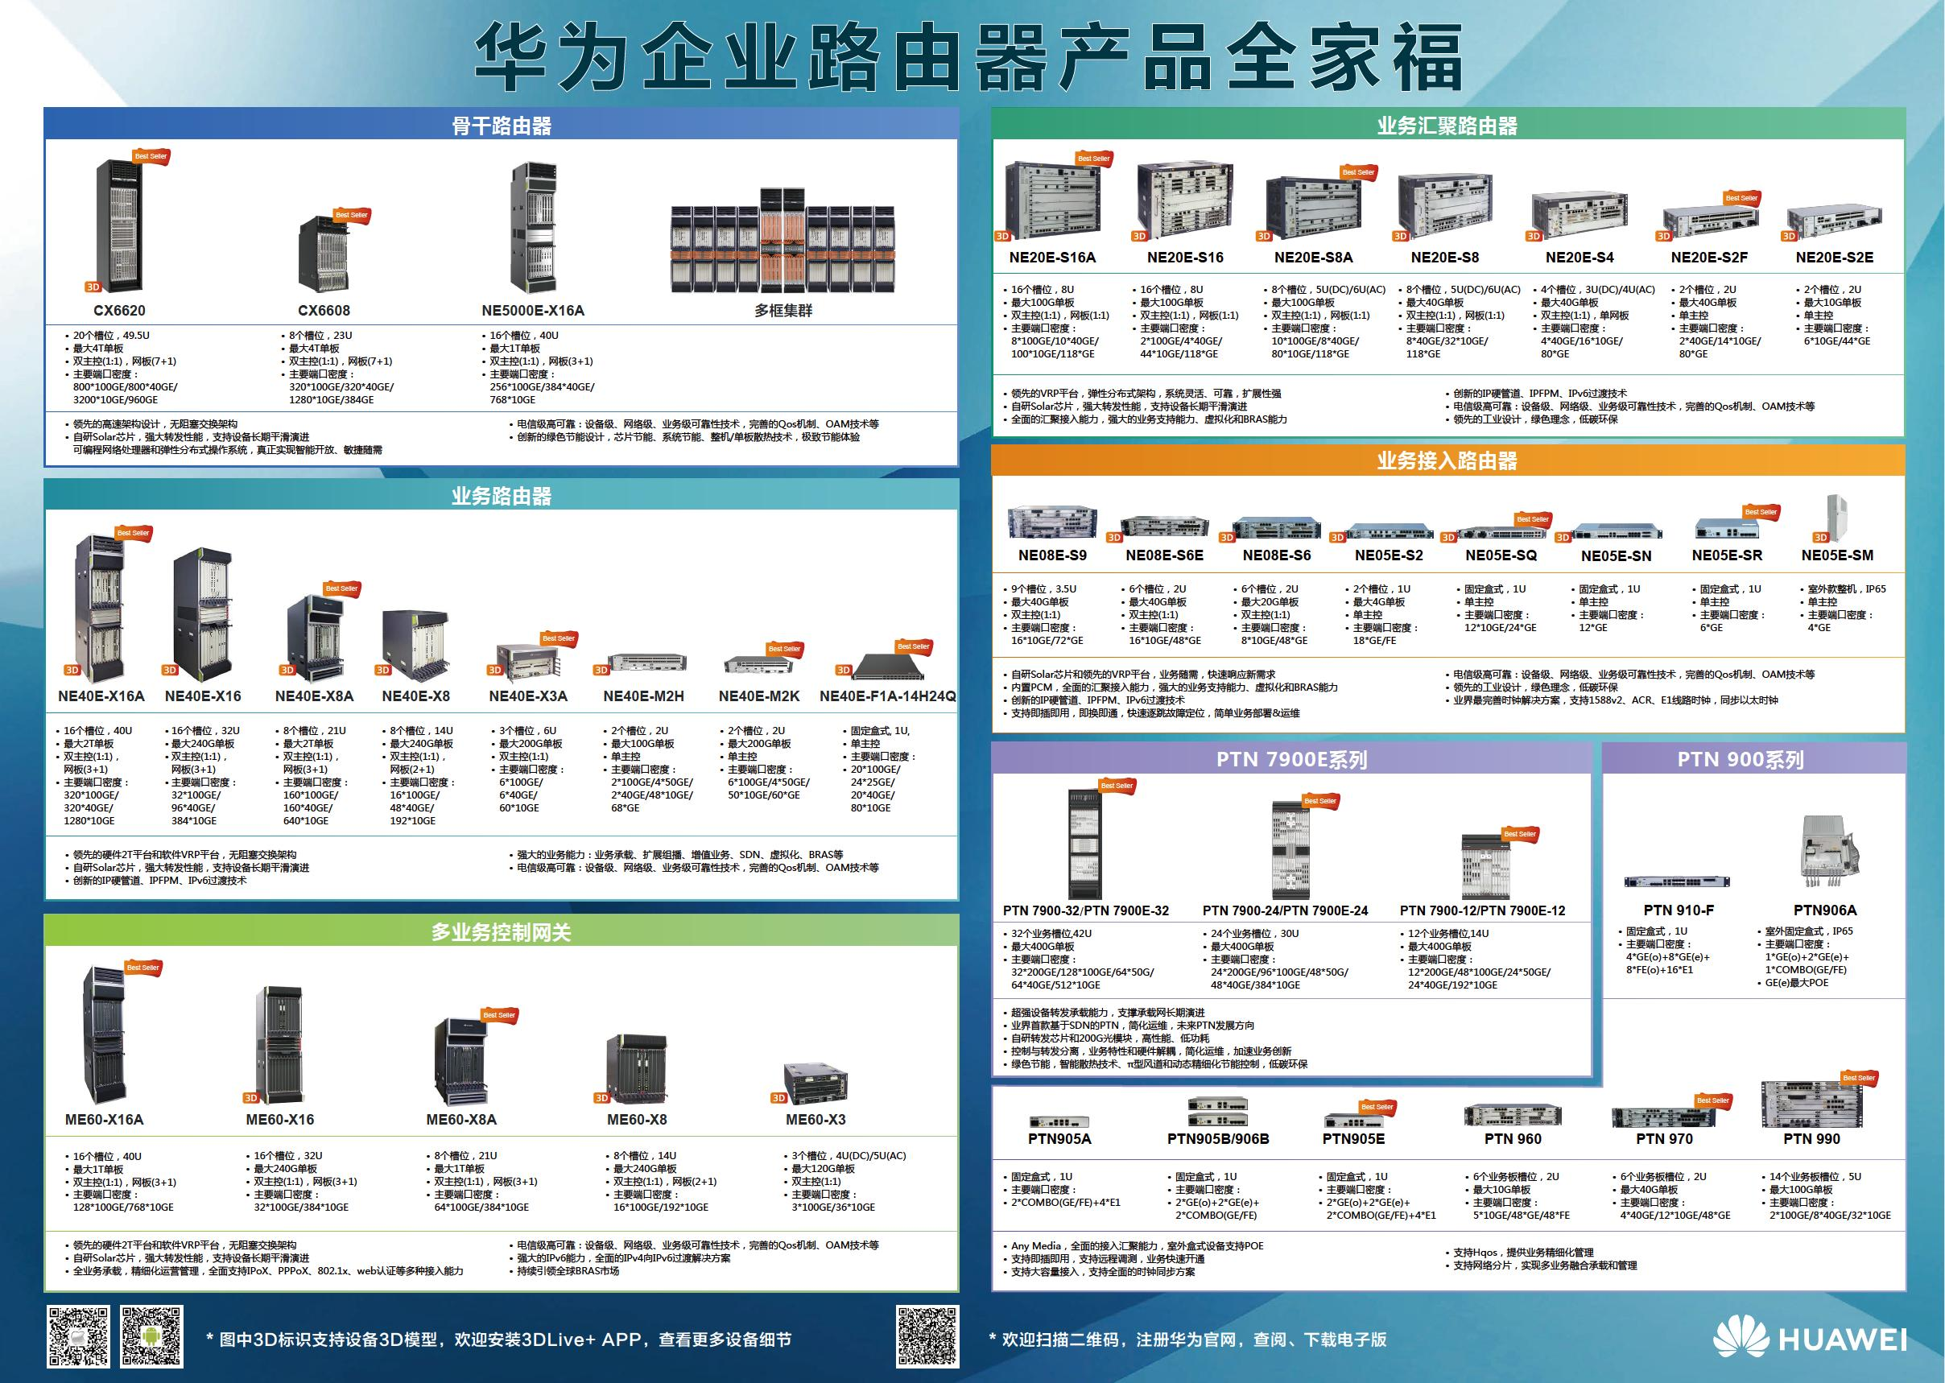
Routers

Slide 21
Two Processes inside a Router
Routing: discover network paths
Make the decision which route to use
Fill and update the routing tables
Depends on a distributed algorithm
Forwarding: send packets along a path
handles each packet as it arrives, looking up the outgoing line to use for it in the routing tables
Locally done at a node

Slide 22
Routing Algorithms (1 of 2)
Model the network as a graph of nodes and links
Learn about the topology of the network
Manage routing tables
Make routing decisions
R1
1
R2
2
R3
Notes:
topology of the network: the set of all routers and links
weighted graph (vertex: router, edge: link, weight: cost)
Criterion: best path from source to destination
“best”: path cost is minimum

Slide 23
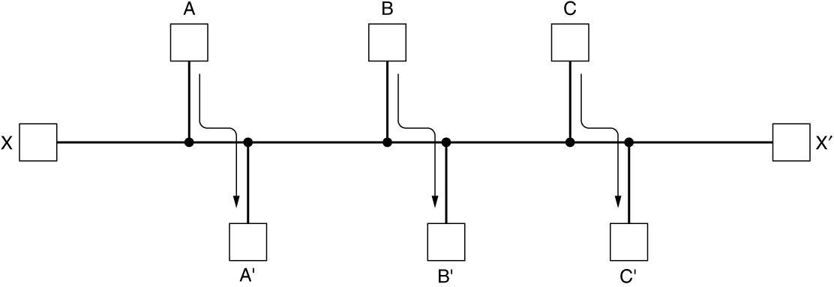
Routing Algorithms (2 of 2)
Desired properties
Correctness
Simplicity
Robustness
Stability
Fairness
Optimality
Decide what to optimize (e.g., fairness vs efficiency)
Update routes for changes in topology (e.g., failures)
Network with a conflict between fairness and efficiency

Slide 24
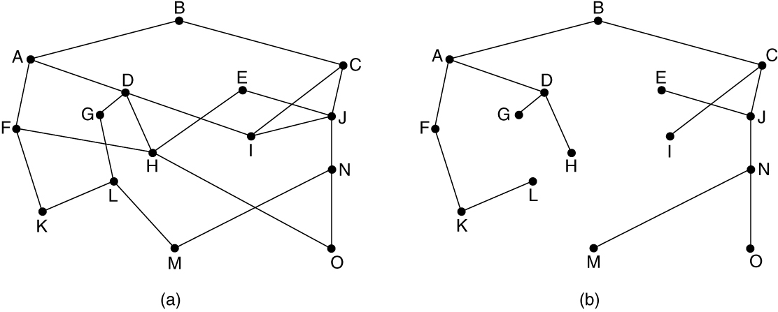
The Optimality Principle
Each portion of a best path is also a best path; the union of them to a router is a tree called the sink tree
Best means fewest hops in the example
(a) A network. (b) A sink tree for router B.

Slide 25
Shortest Path Algorithm (1 of 3)
Dijkstra’s algorithm computes a sink tree on the graph:
Each link is assigned a non-negative weight/distance
Shortest path is the one with lowest total weight
Using weights of 1 gives paths with fewest hops
Algorithm:
Start with sink, set distance at other nodes to infinity
Relax distance to other nodes
Pick the lowest distance node, add it to sink tree
Repeat until all nodes are in the sink tree
Notes:
The notion of weight generalizes distance to other cost metrics. Setting weights to be 1 gives paths with fewest hops. Setting weight to be distance gives paths that are shortest or lowest delay. Setting weight to be lower for higher capacity links favors higher capacity paths.

Slide 26
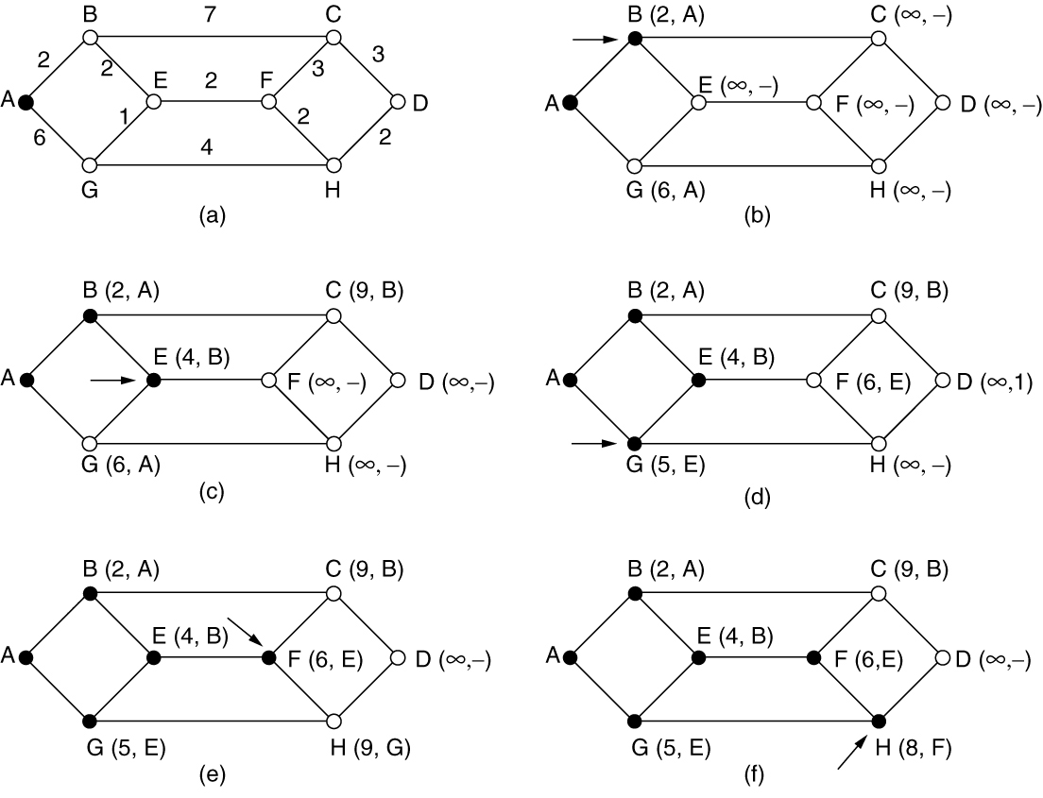
Shortest Path Algorithm (2 of 3)
The first six steps used in computing the shortest path from A to D. The arrows indicate the working node.

Slide 27
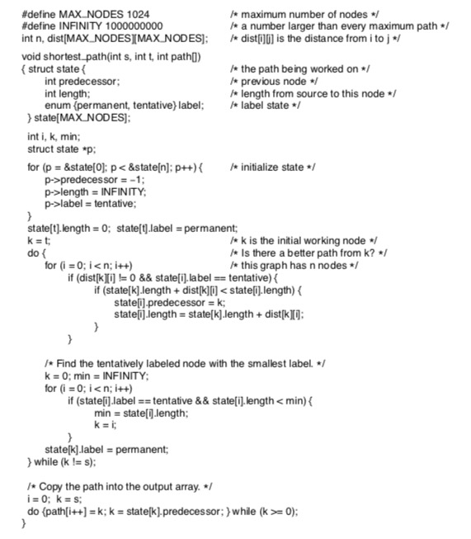
Shortest Path Algorithm (3 of 3)
Start with the sink, all other nodes are unreachable
Relaxation step. Lower distance to nodes linked to newest member of the sink tree
Find the lowest distance, add it to the sink tree, and repeat until done
Dijkstra’s algorithm to compute the shortest path through a graph

Slide 28
Flooding
A simple method to send a packet to all network nodes
Each node floods a new packet received on an incoming link by sending it out all of the other links
Nodes need to keep track of flooded packets to stop the flood; even using a hop limit can blow up exponentially
Flooding is not practical:
Sending most packets
Wasteful
Flooding is Useful:
Ensures that a packet is delivered to every node.
Effective for broadcasting information.
Tremendously robust and localized.
Will find a path if one exists.
Routers only need to know their neighbors.
Notes:
Note that flooding doesn’t actually find any routes that can be reused.

Slide 29
Distance Vector Routing
Distance vector is a distributed routing algorithm
Shortest path computation is split across nodes
Bellman-ford ( Ford-Fulkerson) Algorithm
The original ARPANET routing algorithm
Used by RIP, IGRP,…
Algorithm: “tell neighbors where I can go, and how far”
Each node knows distance of links to its neighbors
Each node advertises vector of lowest known distances to all neighbors
Each node uses received vectors to update its own
Repeat periodically
Notes:
How long will it take to converge? The diameter of the network.

Slide 30
Example of Distance Vector
A’s routing table
Destination Y | Cost/Next-Hop
A B C D E F G | 0/lo 1/B 1/C 2/C 1/E 1/F 2/F
B
A
C
E
D
F
G
Distance Vector sent by A

Slide 31
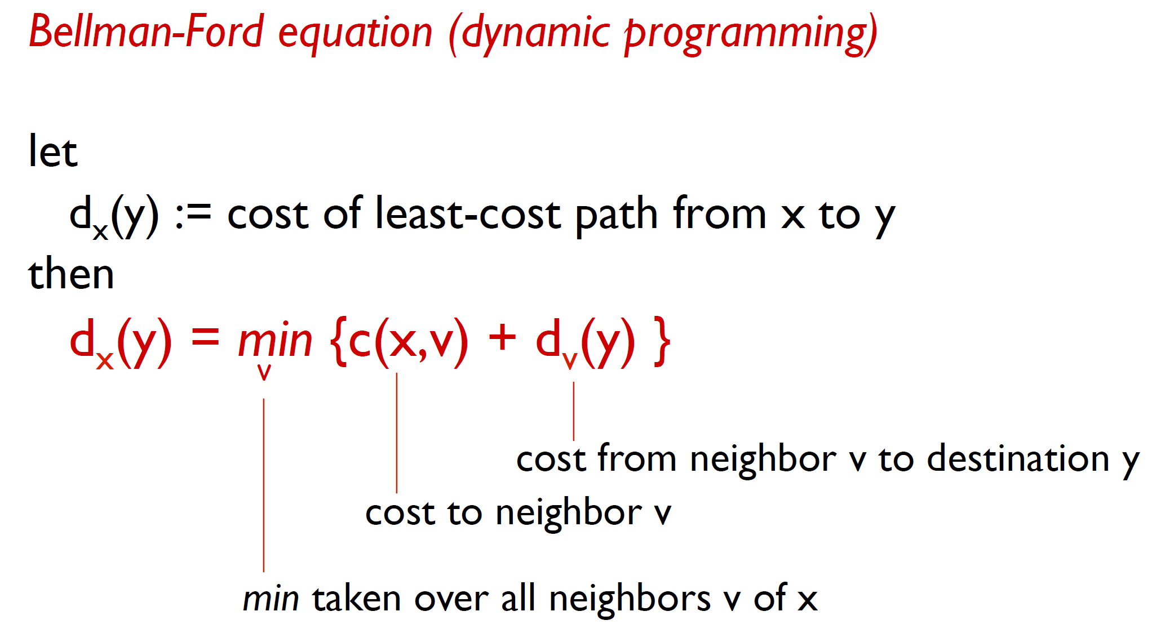
Bellman-Ford Equation

Slide 32
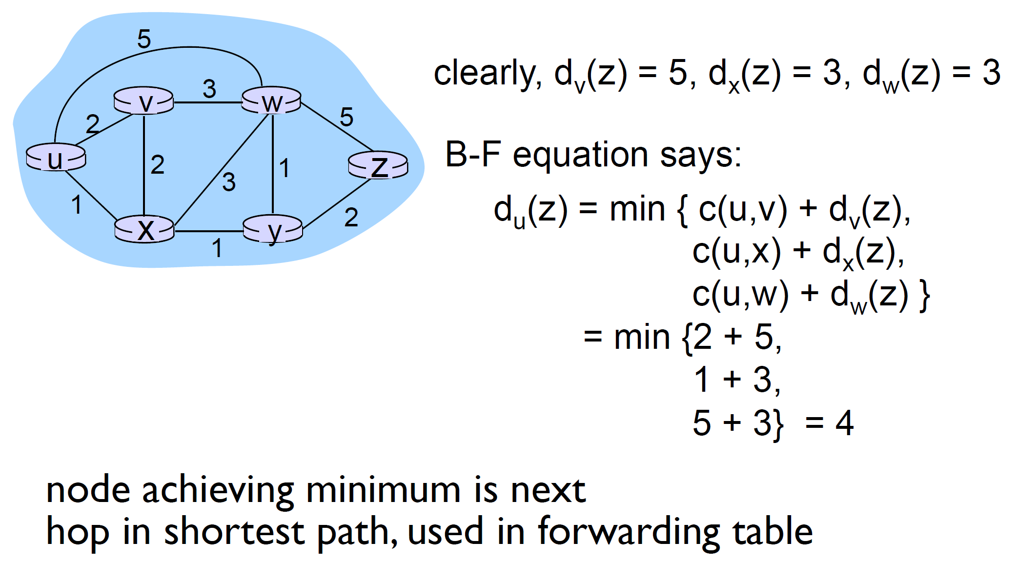
Example

Slide 33
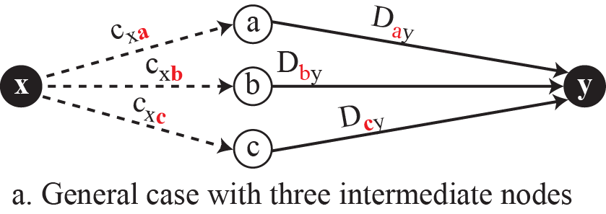
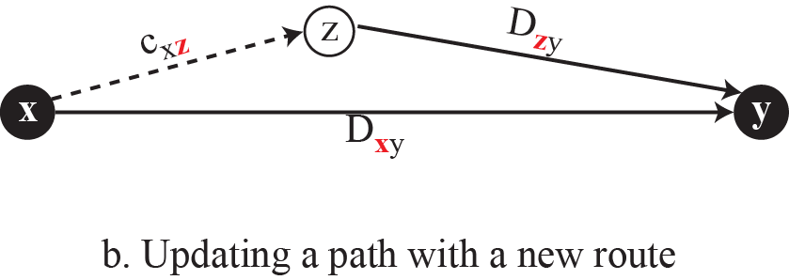
Graphical idea behind Bellman-Ford equation

Slide 34

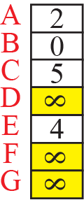

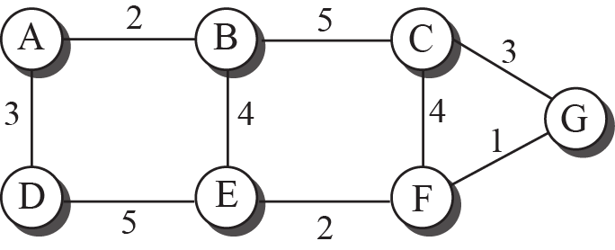




The first distance vector for an internet

Slide 35
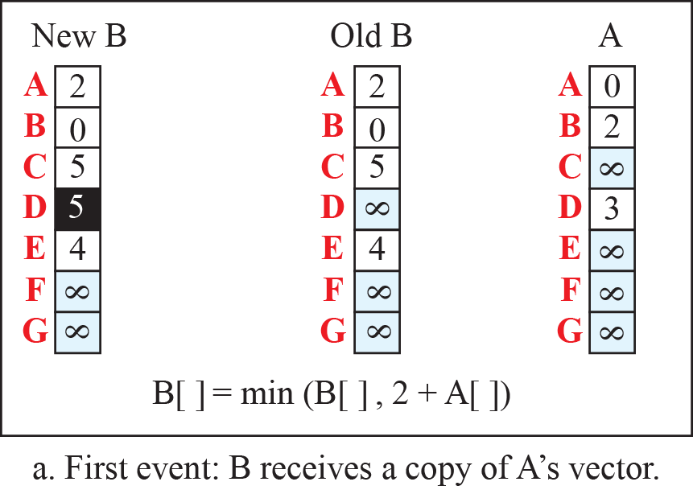

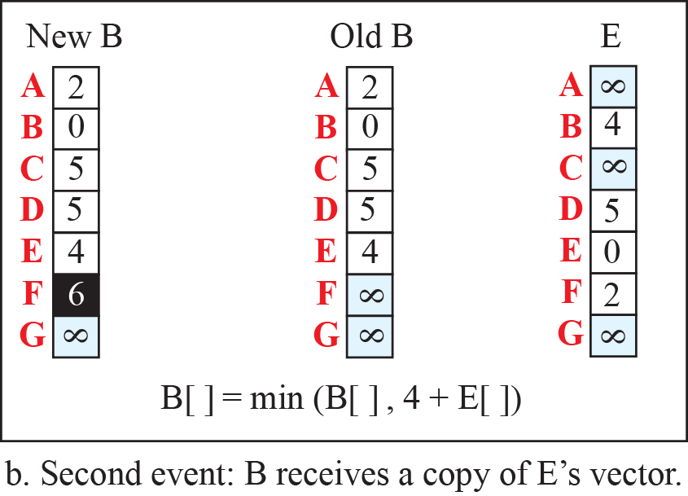
Updating distance vectors

Slide 36
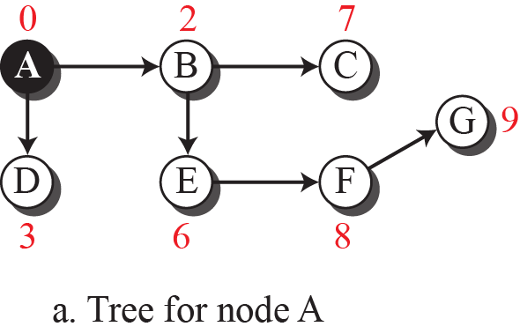
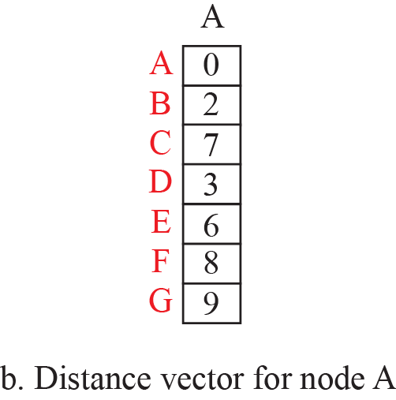
The distance vector corresponding to a tree

Slide 37
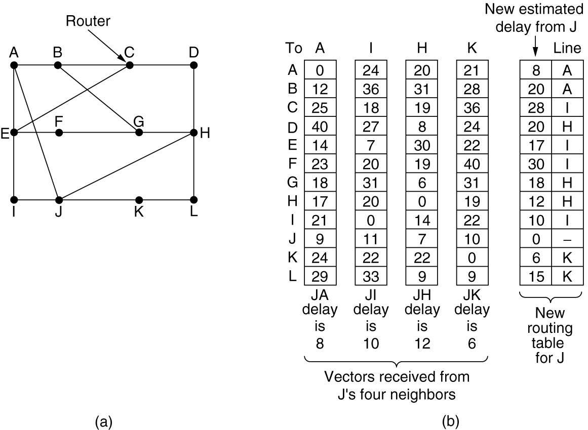
Distance Vector Routing
(a) A network. (b) Input from A, I, H, K, and the new routing table for J.

Slide 38
Exercises
B
A
C
Give the establishment process for each router’s routing table.
E
D
F
G
Destination Y |  | Node X’s Routing Table: Cost / Next-Hop
 |  | A’s | B’s | C’s | D’s | E’s | F’s | G’s
A |  | 0 | 1/A | 1/A | ∞ | 1/A | 1/A | ∞
B |  | 1/B | 0 | 1/B | ∞ | ∞ | ∞ | ∞
C |  | 1/C | 1/C | 0 | 1/C | ∞ | ∞ | ∞
D |  | ∞ | ∞ | 1/D | 0 | ∞ | ∞ | 1/D
E |  | 1/E | ∞ | ∞ | ∞ | 0 | ∞ | ∞
F |  | 1/F | ∞ | ∞ | ∞ | ∞ | 0 | 1/F
G |  | ∞ | ∞ | ∞ | 1/G | ∞ | 1/G | 0

Slide 39
After One Step
B
A
C
E
D
F
G
Destination Y |  | Node X’s Routing Table: Cost / Next-Hop
 |  | A’s | B’s | C’s | D’s | E’s | F’s | G’s
A |  | 0 | 1/A | 1/A | 2/C | 1/A | 1/A | 2/F
B |  | 1/B | 0 | 1/B | 2/C | 2/A | 2/A | ∞
C |  | 1/C | 1/C | 0 | 1/C | 2/A | 2/A | 2/D
D |  | 2/C | 2/C | 1/D | 0 | ∞ | 2/G | 1/D
E |  | 1/E | 2/A | 2/A | ∞ | 0 | 2/A | ∞
F |  | 1/F | 2/A | 2/A | 2/G | 2/A | 0 | 1/F
G |  | 2/F | ∞ | 2/D | 1/G | ∞ | 1/G | 0

Slide 40
After Two Step
B
A
C
E
D
F
G
Destination Y |  | Node X’s Routing Table: Cost / Next-Hop
 |  | A’s | B’s | C’s | D’s | E’s | F’s | G’s
A |  | 0 | 1/A | 1/A | 2/C | 1/A | 1/A | 2/F
B |  | 1/B | 0 | 1/B | 2/C | 2/A | 2/A | 3/F
C |  | 1/C | 1/C | 0 | 1/C | 2/A | 2/A | 2/D
D |  | 2/C | 2/C | 1/D | 0 | 3/A | 2/G | 1/D
E |  | 1/E | 2/A | 2/A | 3/C | 0 | 2/A | 3/F
F |  | 1/F | 2/A | 2/A | 2/G | 2/A | 0 | 1/F
G |  | 2/F | 3/C | 2/D | 1/G | 3/A | 1/G | 0
Notes:
convergence: no more changes when getting further announcement

Slide 41
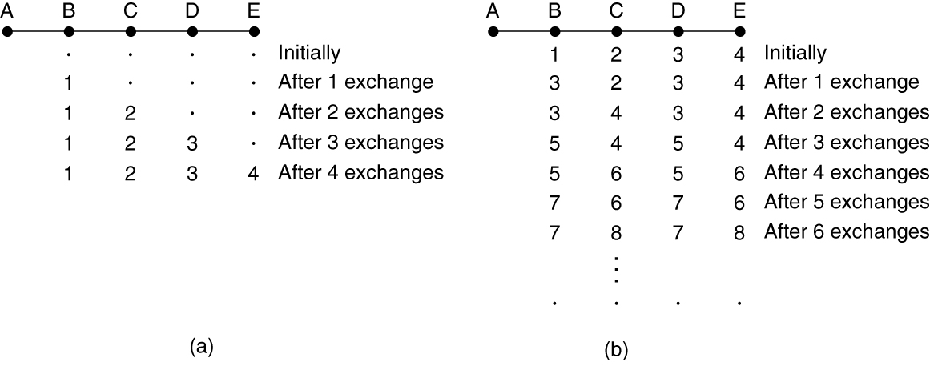
The Count-to-Infinity Problem
Failures can cause DV to “count to infinity” while seeking a path to an unreachable node
Good news of a path to A spreads quickly
Bad news of no path to A is learned slowly
The count-to-infinity problem

Slide 42
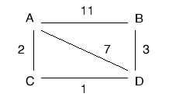
Exercises
考虑如下子网，A、B、C、D为路由器。采用距离矢量路由算法。
（1）分析A路由器的路由表中存储的A到路由器B的距离及形成过程。
（2）假设链路BD断开，分析A路由器的路由表中存储的A到路由器B的距离的变化过程。
（3）在链路BD断开一段时间后，进一步假设链路AB也断开，分析A路由器在构造路由表，生成A到路由器B的距离时会出现什么问题？
答：
（1）A初始时记录到B的距离为11。当A收到D发来的申明：“到B的距离为3”，A修改自己的路由表项：“到B的距离为10，通过D”；同时C申明：“到B的距离为4，通过D”，故A修改其路由表：“到A的距离为6，通过C”。
（2）所有路由器重新查找到B的路径。所有路由器通过A到B。路由器A到B的距离为11。
（3）会出现“无穷计算问题”。

Slide 43

Exercises
对于下图所示的通信子网，采用距离矢量路由选择算法。当以下矢量刚进入路由器C：
来自B：(5，0，8，12，6，2)表示B到A、B、C、D、E、F的延迟分别为5，0，8，12，6，2
来自D：(16，12，6，0，9，10)表示D到A、B、C、D、E、F的延迟分别为16，12，6，0，9，10
来自E：(7，6，3，9，0，4)表示E到A、B、C、D、E、F的延迟分别为7，6，3，9，0，4
C到B、D、E的延迟分别为6，3，5。请问C的路由表是什么？即给出采用的输出线路和预计延迟。
答：
目的地 | 预计延迟 | 输出线路
A | 11 | B
B | 6 | B
C | 0 | -
D | 3 | D
E | 5 | E
F | 8 | B

Slide 44
Link State Routing
Link state is an alternative to distance vector
“tell all which neighbors I have”
More computation but simpler dynamics
Widely used in the Internet (OSPF, ISIS)
Algorithm:
Discover neighbors, learn network addresses
Set distance/cost metric to each neighbor
Construct packet telling all it has learned
Send packet to, receive packets from other routers
Compute shortest path to every other router

Slide 45

Learning about the Neighbors
(a) Nine routers and a broadcast LAN. (b) A graph model of (a).
Notes:
通过发送Hello分组来实现。
可以将LAN视作一个结点考虑。
在初始情况下，A、B在某个接口激活了OSPF后，都会开始在这个接口上去发组播的HELLO包，目的是发现OSPF邻居。HELLO包里，有个active neighbor字段，用来存储路由器在某个OSPF接口上发现的邻居，当然，初始情况下，这个HELLO包里是不包含任何活跃的邻居的（也就没有active neighbor字段），因为他谁也没发现。
当OSPF路由器（B）在某个OSPF接口上收到邻居发来的HELLO包（里面没有装active neighbor），它会记录下A（在自己的OSPF接口数据结构中）并且将A的状态视为init，然后将A的RouterID存储在自己将要发送的HELLO包的active neighbor字段里发送出去，这样A就会收到这个hello包，并且在这个hello包当中找到自己的RouterID，那么A会认为，与B已经完成了双边关系的建立，因此A会将B的邻居状态置为two-way。 与此同时，A也会继续发送HELLO包，并且将B的routerID放置于HELLO包中，而B收到这个hello包并看见了自己的RouterID后，B也会将A的状态置为two-way，至此OSPF的第一个稳态就达到了。

Slide 46

Building Link State Packets
LSP (Link State Packet) for a node lists neighbors and weights of links to reach them
(a) A network. (b) The link state packets for this network.

Slide 47


Distributing the Link State Packets
Seq. number and age are used for reliable flooding
New LSPs are acknowledged on the lines they are received and sent on all other lines
Example shows the LSP database at router B
the packet must be sent on the indicated link
it must be acknowledged there
decrement it once per second
The packet buffer for router B in Fig. 5-12(a)
Notes:
In the example, B has links to A, C and F in the network. It received LSPs from A, C, and F directly and so acknowledged A, C, and F respectively and sent that LSP on both other links. But B received E and D on two links, so it acknowledged both and sent only on the third link.
The LSP from A arrives directly, so it must be sent to C and F and ACKed to A, as indicated by the flag bits. Similarly, the packet from F has to be forwarded to A and C and ACKed to F.
However, packet from E, is different. It arrives twice, once via EAB and once via EFB. Consequently, it has to be sent only to C but must be ACKed to both A and F, as indicated by the bits.
Age filed: decrement it once per second. When the age hits zero, the information from that router is discarded.

Slide 48

Hierarchical Routing within a Network
Hierarchical routing reduces the work of route computation but may result in slightly longer paths than flat routing
Advantages：
smaller routing tables,
smaller routing computations to run at nodes,
and fewer/smaller messages to send to describe the network.
Hierarchical routing

Slide 49

Broadcast Routing
Broadcast sends a packet to all nodes
RPF (Reverse Path Forwarding): send broadcast received on the link to the source out all remaining links
Alternatively, can build and use sink trees at all nodes
Reverse path forwarding. (a) A network. (b) Sink tree for router I. (c) The tree built by reverse path forwarding from I.

Slide 50

Multicast Routing (1 of 2)
Multicast sends to a subset of the nodes called a group
Uses a different tree for each group and source
(a) A network. (b) A spanning tree for the leftmost router. (c) A multicast tree for group 1. (d) A multicast tree for group 2.
Notes:
The example shows two of the multicast trees computed in the network. There are many more, the number of nodes times the number of groups. This is worth the effort when the group densely cover the network, i.e., most groups affect most nodes in the network so it makes sense for all nodes to build an efficient multicast tree.

Slide 51

Multicast Routing (2 of 2)
CBT (Core-Based Tree) uses a single tree to multicast
Tree is the sink tree from core node to group members
Multicast heads to the core until it reaches the CBT
(a) Core-based tree for group 1. (b) Sending to group 1.
Notes:
Tradeoff is that CBT is less efficient than computing the spanning tree for each source to reach each group, but it is less work to scale to large networks and many groups. Now, with CBT, nodes that are not on the group spanning tree do not need to compute it and can simply send to the core node using their regular routing tables. This is a good tradeoff when the groups sparsely cover the network, i.e., there are many groups that most nodes do not need to know about.

Slide 52

Anycast Routing
Anycast sends a packet to one (nearest) group member
Falls out of regular routing with a node in many places
(a) Anycast routes to group 1. (b) Topology seen by the routing protocol.
Notes:
We will see later that anycast is used in practice to reach the nearest root DNS server.

Slide 53
The Network Layer Chapter 5
Network Layer Design Issues
Routing Algorithms in a Single Network
Traffic Management at the Network Layer
Quality of Service and Application QoE
Internetworking
Software Defined Networking
The Network Layer in the Internet
Policy at the Network layer
Summary

Slide 54
Traffic Management at the Network Layer
The need for traffic management: congestion
Approaches to traffic management
Traffic-aware routing
Admission control
Load shedding
Traffic shaping
Active queue management
Random early detection
Choke packets
Explicit congestion notification
Hop-by-hop backpressure

Slide 55

Congestion
Congestion results when too much traffic is offered; performance degrades due to loss/retransmissions
Goodput (=useful packets) trails offered load
Performance drops significantly in the presence of congestion: packet loss rates increase, and latency also increases as router queues fill with packets
Notes:
As offered load increases, goodput should increase correspondingly until the capacity of the network is reached. Goodput will trail offered load because the load is bursty and queues will occasionally be too full and a packet will be discarded inside the network.
Congestion collapse can occur if the protocols are not carefully designed when nodes retransmit packets many times, believing that they have been lost, when copies of the packet are still in the network (in queues at routers) pending delivery. While throughput at a receiver may be high, goodput falls because multiple copies of the same packet are being received and after the first copy the bandwidth is wasted.
This really happened in the late 1980s as the Internet grew, and it lead to the design of modern TCP that includes congestion control mechanisms.

Slide 56

Approaches to Traffic Management
Network must do its best with the offered load
Different approaches at different timescales
Nodes should also reduce offered load (Transport)
Timescales of approaches to traffic and congestion management
Notes:
Provisioning is simply sizing the network to fit the offered load, i.e., don’t build it too small, or with little West-to-East capacity if there is much West-to-East traffic.

Slide 57

Traffic-Aware Routing
Choose routes depending on traffic, not just topology
E.g., use EI for West-to-East traffic if CF is loaded
But take care to avoid oscillations
A network in which the East and West parts are connected by two links
Notes:
Our previous routes only considered topology; this approach can get more traffic through the network.
If not careful, then routing can notice CF is busy and switch traffic over to use EI, only to later notice that EI is busy and switch traffic back to CF. There are various techniques to avoid this: 1) change routes only slowly, e.g., traffic engineering in which an external system sets weights and the routing system does not otherwise adapt; and 2) using multiple paths at once, e.g., both CF and EI.

Slide 58

Admission Control
Admission control allows a new traffic load only if the network has sufficient capacity, e.g., with virtual circuits
Can combine with looking for an uncongested route
(a) A congested network. (b) The portion of the network that is not congested. A virtual circuit from A to B is also shown.
Notes:
One technique that is widely used in virtual-circuit networks to keep congestion at bay is admission control. The idea is simple: do not set up a new virtual circuit unless the network can carry the added traffic without becoming congest-ed.

Slide 59

Traffic Shaping (1 of 2)
Traffic shaping regulates the average rate and burstiness of data entering the network
Token/Leaky bucket limits both the average rate (R) and short-term burst (B) of traffic
(a) Shaping packets. (b) A leaky bucket. (c) A token bucket.

Slide 60

Traffic Shaping (2 of 2)
Host traffic
R=200 Mbps B=16000 KB
Shaped by R=200 Mbps B=9600 KB
Shaped by R=200 Mbps B=0 KB
(a) Traffic from a host. Output shaped by a token bucket of rate 200 Mbps and capacity (b) 9600 KB and (c) 0 KB. Token bucket level for shaping with rate 200 Mbps and capacity (d) 16,000 KB, (e) 9600 KB, and (f) 0 KB.

Slide 61

Explicit Congestion Notification
Congested routers signal hosts to slow down traffic
ECN (Explicit Congestion Notification) marks packets and receiver returns signal to sender
Explicit congestion notification

Slide 62

Hop-by-Hop Backpressure
When all else fails, network will drop packets (shed load)
Can be done end-to-end or link-by-link
Link-by-link produces rapid relief
End-to-end takes longer to have an effect, but can better target the cause of congestion
(a) A choke packet that affects only the source. (b) A choke packet that affects each hop it passes through.

Slide 63
The Network Layer Chapter 5
Network Layer Design Issues
Routing Algorithms in a Single Network
Traffic Management at the Network Layer
Quality of Service and Application QoE
Internetworking
Software Defined Networking
The Network Layer in the Internet
Policy at the Network layer
Summary

Slide 64
Quality of Service and Application QoE
Application QoS requirements
Overprovisioning
Packet scheduling
Integrated services
RSVP—The Resource reSerVation Protocol
Differentiated services
Expedited forwarding
Assured forwarding

Slide 65

Application QoS Requirements
Stringency of applications’ quality-of-service requirements

Slide 66
Categories of QoS and Examples
Constant bit rate
Telephony
Real-time variable bit rate
Compressed videoconferencing
Non-real-time variable bit rate
Watching a movie on demand
Available bit rate
File transfer

Slide 67
Overprovisioning
Helps to provide good quality of service
Ensure the network has the capacity for all traffic
Expensive solution
Network issues to address for quality of service
Addressing applications needs
Regulating traffic entering the network
Reserving resources at routers to guarantee performance
Safely accepting more traffic

Slide 68
Packet Scheduling
Router resources reserved for different flows
Bandwidth
Buffer space
CPU cycles
Algorithms
First-In First-Out (FIFO) scheduling
Fair queueing
Weighted fair queueing
Putting it together

Slide 69

Fair Queueing (1 of 2)
The algorithm gives more bandwidth to hosts that use large packets than to hosts that use small packets.
Round-robin fair queueing

Slide 70

Fair Queueing (2 of 2)
Fair Queueing approximates bit-level fairness with different packet sizes; weights change target levels
Result is WFQ (Weighted Fair Queueing)
Packets may be sent out of arrival order
(a) Weighted Fair Queueing. (b) Finishing times for the packets.
Finish virtual times determine transmission order

Slide 71

Putting it Together (1 of 2)
Admission control takes a traffic flow specification and decides whether the network can carry it
Sets up packet scheduling to meet QoS
An example flow specification

Slide 72

Putting it Together (2 of 2)
Construction to guarantee bandwidth B and delay D:
Shape traffic source to a (R, B) token bucket
Run WFQ with weight W / all weights > R/capacity: Bandwidth is guaranteed at each router by setting a high enough weight on the flow. If it cannot be given a large enough rate, the flow cannot be admitted.
Holds for all traffic patterns, all topologies
E.g.,
flow rate: 1 Mbps,
capacity of the router and output link: 1 Gbps,
the weight for the flow must be greater than 1/1000th of the total of the weights for all of the flows at that router for the output link.
total delay ≈ propagation delay + B/R
Bandwidth and delay guarantees with token buckets and WFQ
Notes:
Bandwidth is guaranteed at each router by setting a high enough weight on the flow; if this cannot be done then the flow must not be admitted.
Delay guarantees are more subtle and the bound is not given here. Essentially a burst of traffic can arrive at one router and be delayed but then it will not be delayed at other routers because it has already been shaped to be less bursty. So the total delay is something like the propagation delay plus B/R.

Slide 73

Integrated Services (1 of 3)
Design with QoS for each flow; handles multicast traffic.
Admission with RSVP (Resource reSerVation Protocol):
Receiver sends a request back to the sender
Each router along the way reserves resources
Routers merge multiple requests for same flow
Entire path is set up, or reservation not made
(a) A network. (b) The multicast spanning tree for host 1. (c) The multicast spanning tree for host 2.

Slide 74

Integrated Services (2 of 3)
(a) Host 3 requests a channel to host 1. (b) Host 3 then requests a second channel, to host 2. (c) Host 5 requests a channel to host 1.

Slide 75
Integrated Services (3 of 3)
在传送数据之前，根据业务的QoS需求进行网络资源预留，从而为该数据流提供端到端QoS保证。
通常采用面向流的资源预留协议（RSVP），在流传输路径上的每个节点为流预留并维护资源。
主机利用RSVP向网络为应用流提出QoS的请求；
路由器利用RSVP将QoS请求信息传给流的路径中的其他路由器，并建立和保存该服务的信息；RSVP请求将会使得沿着数据路径的资源在路由器处预留。
优点是能提供端到端的绝对的QoS保证，但在实现上是非常困难的，主要体现在：
由于预留是基于每个流而进行的，因此使得节点中要保留每个流的状态信息，导致核心路由器负担太重，因此可扩展性很差。
网络中每个节点都要维护各类数据库，并实现复杂的功能模块（如资源预留、路由、接纳控制等），造成了极大的复杂性。

Slide 76

Differentiated Services (1 of 4)
Design with classes of QoS; customers buy what they want
Expedited class is sent in preference to regular class
Less expedited traffic but better quality for applications
Expedited packets experience a traffic-free network

Slide 77

Differentiated Services (2 of 4)
Implementation of DiffServ:
Customers mark desired class on packet
ISP shapes traffic to ensure markings are paid for
Routers use WFQ to give different service levels
A possible implementation of assured forwarding

Slide 78
Differentiated Services (3 of 4)
在网络的入口处为每个数据包分类，并在数据包中标记相应的区分服务代码点（DSCP，DiffServ CodePoint），用于指示数据包在网络转发路径的中间节点上被处理的方式。
网络内部的核心路由器只保存简单的DSCP与PHB（Per-Hop Behavior, 每跳行为）的对应机制，根据数据包头部中的DSCP值对数据包进行相应的优先级转发
业务流状态信息的保存与流量控制机制的实现等都在网络边界节点进行，内部节点与状态无关。

Slide 79
Differentiated Services (4 of 4)
特点：实现简单，扩展性好。目前在IP网中区分服务得到了绝大部分厂家的支持，其具体实现技术包括分类、重标记、速率限制、流量监管、拥塞避免、队列调度等。
局限性：
只承诺相对的服务质量，因而不能对用户提供绝对的服务质量保证。
在拥塞发生时，只能采取丢弃报文的方式，而不能采用例如旁路的方式使部分流量通过其他路径到达终点。
对相同优先级的业务而言，设备在拥塞时对报文的丢弃是非智能化的，也就是说，设备只能随机地丢弃报文，其结果是所有业务的服务质量都受到影响。而此时希望的结果是只丢弃少部分业务流的报文，从而避免剩下的大多数的业务流的服务质量受到影响。

Slide 80
The Network Layer Chapter 5
Network Layer Design Issues
Routing Algorithms in a Single Network
Traffic Management at the Network Layer
Quality of Service and Application QoE
Internetworking
Software Defined Networking
The Network Layer in the Internet
Policy at the Network layer
Summary

Slide 81
Internetworking
Internetworks: an overview
How networks differ
Connecting heterogeneous networks
Connecting endpoints across heterogeneous networks
Internetwork routing: routing across multiple networks
Supporting different packet sizes: packet fragmentation

Slide 82

How Networks Differ
Some of the many ways networks can differ

Slide 83

Connecting Heterogeneous Networks
Internetworking based on a common network layer – IP
(a) A packet crossing different networks. (b) Network and link layer protocol processing.

Slide 84

Connecting Endpoints Across Heterogeneous Networks (1 of 2)
Connects two networks through a middle one
Packets are encapsulates over the middle
Tunneling a packet from Paris to London

Slide 85

Connecting Endpoints Across Heterogeneous Networks (2 of 2)
Tunneling analogy:
tunnel is a link; packet can only enter/exit at ends
Tunneling a car from France to England

Slide 86

Supporting Different Packet Sizes: Packet Fragmentation (1 of 3)
Networks have different packet size limits for many reasons
Large packets sent with fragmentation & reassembly
(a) Transparent fragmentation. (b) Nontransparent fragmentation.
Notes:
Each network or link imposes some maximum size on its packets. These limits have various causes, among them：
1. Hardware (e.g., the size of an Ethernet frame).
2. Operating system (e.g., all buffers are 512 bytes).
3. Protocols (e.g., the number of bits in the packet length field).
4. Compliance with some (inter)national standard.
5. Desire to reduce error-induced retransmissions to some level.
6. Desire to prevent one packet from occupying the channel too long.

Slide 87

Supporting Different Packet Sizes: Packet Fragmentation (2 of 3)
Fragmentation when the elementary data size is 1 byte. (a) Original packet, containing 10 data bytes. (b) Fragments after passing through a network with maximum packet size of 8 payload bytes plus header. (c) Fragments after passing through a size 5 gateway.

Slide 88

Supporting Different Packet Sizes: Packet Fragmentation (3 of 3)
Path MTU Discovery avoids network fragmentation
Routers return MTU (Max. Transmission Unit) to source and discard large packets
Path MTU discovery
Notes:
Each IP packet is sent with its header bits set to indicate that no fragmentation is allowed to be performed.
If a router receives a packet that is too large, it generates an error packet, returns it to the source, and drops the packet.
When the source receives the error packet, it uses the information inside to refragment the packet into pieces that are small enough for the router to handle.
If a router further down the path has an even smaller MTU, the process is repeated.

Slide 89
The Network Layer Chapter 5
Network Layer Design Issues
Routing Algorithms in a Single Network
Traffic Management at the Network Layer
Quality of Service and Application QoE
Internetworking
Software Defined Networking
The Network Layer in the Internet
Policy at the Network layer
Summary

Slide 90
Software-Defined Networking
Overview
The SDN control plane: logically centralized software control
The SDN data plane: programmable hardware
Programmable network telemetry

Slide 91

Overview
Control and data plane separation in SDN

Slide 92
The SDN Data Plane: Programmable Hardware (1 of 2)
Reconfigurable match-action pipeline for a programmable data plane

Slide 93

The SDN Data Plane: Programmable Hardware (2 of 2)
Reconfigurable match-action pipelines on both ingress and egress

Slide 94
The Network Layer Chapter 5
Network Layer Design Issues
Routing Algorithms in a Single Network
Traffic Management at the Network Layer
Quality of Service and Application QoE
Internetworking
Software Defined Networking
The Network Layer in the Internet
Policy at the Network layer
Summary

Slide 95
The Network Layer in the Internet (1 of 3)
Top 10 principles
Make sure it works
Keep it simple
Make clear choices
Exploit modularity
Expect heterogeneity
Avoid static options and parameters
Look for a good design; it need not be perfect
Be strict when sending and tolerant when receiving
Think about scalability
Consider performance and cost
Notes:
1. Make sure it works. Do not finalize the design or standard until multiple prototypes have successfully communicated with each other. All too often, designers first write a 1000-page standard, get it approved, then discover it is deeply flawed and does not work. Then they write version 1.1 of the standard. This is not the way to go.
2. Keep it simple. When in doubt, use the simplest solution. William of Occam stated this principle (Occam’s razor) in the 14th century. Put in modern terms: fight features. If a feature is not absolutely es-sential, leave it out, especially if the same effect can be achieved by combining other features.
3. Make clear choices. If there are several ways of doing the same thing, choose one. Having two or more ways to do the same thing is looking for trouble. Standards often have multiple options or modes or parameters because several powerful parties insist that their way is best. Designers should strongly resist this tendency. Just say no.
4. Exploit modularity. This principle leads directly to the idea of hav-ing protocol stacks, each of whose layers is independent of all the other ones. In this way, if circumstances require one module or layer to be changed, the other ones will not be affected.
5. Expect heterogeneity. Different types of hardware, transmission facilities, and applications will occur on any large network. To handle them, the network design must be simple, general, and flexi-ble.
6. Avoid static options and parameters. If parameters are unavoid-able (e.g., maximum packet size), it is best to have the sender and re-ceiver negotiate a value rather than defining fixed choices.
7. Look for a good design; it need not be perfect. Often, the de-signers have a good design but it cannot handle some weird special case. Rather than messing up the design, the designers should go with the good design and put the burden of working around it on the people with the strange requirements.
8. Be strict when sending and tolerant when receiving. In other words, send only packets that rigorously comply with the standards, but expect incoming packets that may not be fully conformant and try to deal with them.
9. Think about scalability. If the system is to handle millions of hosts and billions of users effectively, no centralized databases of any kind are tolerable and load must be spread as evenly as possible over the available resources.
10. Consider performance and cost. If a network has poor per-formance or outrageous costs, nobody will use it.

Slide 96
The Network Layer in the Internet (2 of 3)
The IP Version 4 Protocol
IP Addresses
IP Version 6
Internet control protocols
Label switching and MPLS
OSPF—An interior gateway routing protocol
BGP—The exterior gateway routing protocol
Internet multicasting

Slide 97

The Network Layer in the Internet (3 of 3)
The Internet is an interconnected collection of many networks.

Slide 98

Position of IP and other network-layer protocols in TCP/IP protocol suite

Slide 99

The IP Version 4 Protocol (1 of 2)
The IPv4 (Internet Protocol version 4) header
Notes:
版本号（Version）：长度4比特。标识目前采用的IP协议的版本号。一般的值为0100（IPv4），IPv6的值（0110）。
IP包头长度（Header Length）：长度4比特。这个字段的作用是为了描述IP包头的长度，因为在IP包头中有变长的可选部分。该部分占4个bit位，单位为32bit（4个字节），即本区域值= IP头部长度（单位为bit）/(8*4)，因此，一个IP包头的长度最长为“1111”，即15*4＝60个字节。IP包头最小长度为20字节。对于标准ipv4报头，这个字段的值肯定是20/4=5（10进制）=0101（2进制）。
服务类型（Type of Service）：长度8比特。这个子段可以拆分成两个部分：Precedence和TOS。TOS目前不太使用。而Precedence则用于QOS("Quality of Service"，中文名为"服务质量")应用。（TOS字段的详细描述RFC 1340 1349）。
IP包总长（Total Length）：长度16比特。以字节为单位计算的IP包的长度 (包括头部和数据)，所以IP包最大长度65535字节。
标识符（Identifier）：长度16比特。该字段和Flag和Fragment Offest字段联合使用，对大的上层数据包进行分段（fragment）操作。
标记（Flag）：长度3比特。该字段第一位不使用。第二位是DF位，DF位设为1时表明路由器不能对该上层数据包分段。如果一个上层数据包无法在不分段的情况下进行转发，则路由器会丢弃该上层数据包并返回一个错误信息。第三位是MF位，当路由器对一个上层数据包分段，则路由器会在最后一个分段的IP包的包头中将MF位设为0,其余IP包的包头中将MF设为1。
Bit 0: reserved, must be zero Bit 1: (DF) 0 = May Fragment, 1 = Don't Fragment. Bit 2: (MF) 0 = Last Fragment, 1 = More Fragments.
分段序号（Fragment Offset）：长度13比特。该字段对包含分段的上层数据包的IP包赋予序号。由于IP包在网络上传送的时候不一定能按顺序到达，这个字段保证了目标路由器在接受到IP包之后能够还原分段的上层数据包。到某个包含分段的上层数据包的IP包在传送是丢失，则整个一系列包含分段的上层数据包的IP包都会被要求重传。
生存时间（Time to Live）：长度8比特。当IP包进行传送时，先会对该字段赋予某个特定的值。当IP包经过每一个沿途的路由器的时候，每个沿途的路由器会将IP包的TTL值减少1。如果TTL减少为0，则该IP包会被丢弃。这个字段可以防止由于故障而导致IP包在网络中不停被转发。
协议（Protocol）：长度8比特。标识了上层所使用的协议。
头部校验（Header Checksum）：长度16比特，由于IP包头是变长的，所以提供一个头部校验来保证IP包头中信息的正确性。
源IP地址（Source IP Addresses）：长度16比特。标识了这个IP包的源IP地址。
目的IP地址（Destination IP Address）：长度16比特。标识了这个IP包的目的IP地址。
可选项（Options）：这是一个可变长的字段，长度为0或32bit的整倍数，最大320bit，如果不足则填充到满。

Slide 100

The IP Version 4 Protocol (2 of 2)
Some of the IP options

Slide 101



Multiplexing and demultiplexing using the value of the protocol field

Slide 102
Example
An IPv4 packet has arrived with the first 8 bits as shown:
01000010
The receiver discards the packet. Why?
Solution
There is an error in this packet. The 4 leftmost bits (0100) show the version, which is correct. The next 4 bits (0010) show an invalid header length (2 × 4 = 8). The minimum number of bytes in the header must be 20. The packet has been corrupted in transmission.

Slide 103
Example
In an IPv4 packet, the value of HLEN is 1000 in binary. How many bytes of options are being carried by this packet?
Solution
The HLEN value is 8, which means the total number of bytes in the header is 8 × 4, or 32 bytes. The first 20 bytes are the base header, the next 12 bytes are the options.

Slide 104

Example
An IPv4 packet has arrived with the first few hexadecimal digits as shown.
How many hops can this packet travel before being dropped? The data belong to what upper-layer protocol?
Solution
To find the time-to-live field, we skip 8 bytes (16 hexadecimal digits). The time-to-live field is the ninth byte, which is (01)₁₆. This means the packet can travel only one hop. The protocol field is the next byte (02)₁₆, which means that the upper-layer protocol is IGMP.

Slide 105



An example of a checksum calculation for an IPv4 header without options
The header is divided into 16-bit sections.
All the sections are added and the sum is complemented after wrapping the leftmost digit.
The result is inserted in the checksum field.

Slide 106
Why the checksum in IPv4 covers only the header, not the data?
1.IPv4数据报中所有的高层协议均有校验和字段来对整个分组进行校验；
2.IPv4头部在经过路由器是会发生改变，而数据字段不变，即校验和仅需要对变化的部分进行校验。
如果对整个分组进行校验，则会增加处理时间。
Notes:
为什么IPv4的checksum字段仅对IPv4头部进行校验？
1.IPv4数据报中所有的高层协议均有校验和字段来对整个分组进行校验；
2.IPv4头部在经过路由器是会发生改变，而数据字段不变，即校验和仅需要对变化的部分进行校验。
如果对整个分组进行校验，则会增加处理时间。

Slide 107


Maximum transfer unit (MTU)
MTUs for some networks
Notes:
A datagram can travel through different networks. Each router decapsulates the IP datagram from the frame it receives, processes it, and then encapsulates it in another frame.
The format and size of the received frame depend on the protocol used by the physical network through which the frame has just traveled.
The format and size of the sent frame depend on the protocol used by the physical network through which the frame is going to travel.
For example, if a router connects a LAN to a WAN, it receives a frame in the LAN format and sends a frame in the WAN format.

Slide 108
IP Fragmentation and Reassembly
length
=4000
ID
=x
fragflag
=0
offset
=0
Example
4000 byte datagram
MTU = 1500 bytes
One large datagram becomes
several smaller datagrams
length
=1500
ID
=x
fragflag
=1
offset
=0
1480 bytes in data field
length
=1500
ID
=x
fragflag
=1
offset
=185
offset =
1480/8
length
=1040
ID
=x
fragflag
=0
offset
=370
Notes:
以太网MTU为1500B，IP头部20B，IP净荷1500-20=1480，正好是8的整数倍。
故按照每个分段中IP净荷1480进行划分。4000-1480-1480=1040

Slide 109
Example: Fragmenting a Packet
A packet is to be forwarded to a network with MTU of 576 bytes. The packet has an IP header of 20 bytes and a data part of 1484 bytes.
For each fragment, Maximum data length per fragment = 576 - 20 = 556 bytes.
We set maximum data length to 552 bytes to get multiple of 8.
 | Total Length | Id | MF | Fragment Offset
Original packet | 1504 | x | 0 | 0
Fragment 1 | 572 | x | 1 | 0
Fragment 2 | 572 | x | 1 | 69
Fragment 3 | 400 | x | 0 | 138
Notes:
576-20=556/8=69..4故选择552作为每个分片净荷的长度

Slide 110
Example
A packet has arrived in which the offset value is 100, the value of HLEN is 5, and the value of the total length field is 100. What are the numbers of the first byte and the last byte?
Solution
The first byte number is 100 × 8 = 800. The total length is 100 bytes, and the header length is 20 bytes (5 × 4), which means that there are 80 bytes in this datagram. If the first byte number is 800, the last byte number must be 879.

Slide 111
IP Addresses
Prefixes
A contiguous block of IP address space
Subnets
CIDR—Classless InterDomain Routing
Classful and special addressing
NAT—Network Address Translation

Slide 112
IPv4 Addresses
An IPv4 address is a 32-bit address that uniquely and universally defines the connection of a device (for example, a computer or a router) to the Internet.
The address space of IPv4 is 2³² or 4,294,967,296.

Slide 113

Dotted-decimal Notation and Binary notation for an IPv4 address

Slide 114
Example
Find the error, if any, in the following IPv4 addresses.
Solution
a. There must be no leading zero (045).
b. There can be no more than four bytes in IP address.
c. Each number needs to be less than or equal to 255.
d. A mixture of binary notation and dotted-decimal notation is not allowed.

Slide 115

Prefixes
Addresses are allocated in blocks called prefixes
Prefix is determined by the network portion
Has 2^{L} addresses aligned on 2^{L} boundary
Written address/length, e.g., 18.0.31.0/24
A prefix and a subnet mask

Slide 116




Information extraction in classless addressing
Set all suffix bits
to 0s
Set all suffix bits
to 1s

Slide 117

A network configuration for the block 205.16.37.32/28

Slide 118

Which address block does an IP address belong to?
In classless addressing, an address cannot per se define the block the address belongs to.
For example, the address 230.8.24.56 can belong to many blocks. Some of them are shown below with the value of the prefix associated with that block.

Slide 119

Subnets
Subnetting splits up IP prefix to help with management
Looks like a single prefix outside the network
2^14=8K addresses
2^15=16K addresses
2^16=32K addresses
2^13=4K addresses
There are 4K addresses left over. What is the prefix?
128.208.64.0/19
Can the prefix lengths just be changed between EE/CS/Art?
Splitting an IP prefix into separate networks with subnetting
No, then blocks of size 2^N would not always be aligned on a 2^N boundary.

Slide 120

Subnet Addressing
Subnet addressing introduces another hierarchical level
Transparent to remote networks
Simplifies management of multiplicity of LANs
Masking used to find subnet number
A class B network subnetted into 64 subnets.
Notes:
子网掩码可以用点分十进制标记法来表示，也可以用”/”并跟上”网络+子网“部分的位数。如上图的例子，子网掩码可以写成255.255.252.0。另一种标记是用”/22“来表示子网掩码有22位长。
P.440例子。
未实使用子网时，每个路由表中列出一些形如（网络,0）的IP地址和一些形如（当前网络，主机）的IP地址。每个表项与能够到达该目标网络的网络接口关联。第一种IP地址说明如何到达远程网络；第二种IP地址说明如何到达本地主机。
当引入子网划分以后，路由表也变了，它加入了形如（当前网络，子网，0）和（当前网络，当前子网，主机）的表项。实际上，每台路由器只需将分组的目标地址与网络的子网掩码进行”与“操作便可消除主机号，然后在路由表中查找确定转发端口。

Slide 121
Subnetting Example
Organization has Class B address (16 host ID bits) with network ID: 150.100.0.0
Create subnets with up to 100 hosts each
7 bits sufficient for each subnet
16-7=9 bits for subnet ID
Apply subnet mask to IP addresses to find corresponding subnet
Example: Find subnet for 150.100.12.176
IP add = 10010110 01100100 00001100 10110000
Mask = 11111111 11111111 11111111 10000000
AND = 10010110 01100100 00001100 10000000
Subnet = 150.100.12.128
Subnet address used by routers within organization

Slide 122

Configuration and Addresses in a Subnetted Network
16
32
16

Slide 123

Three-level hierarchy in an IPv4 address

Slide 124

CIDR—Classless InterDomain Routing (1 of 3)
A set of IP address assignments
Notes:
CIDR——无类别域间路由。是一种为解决地址耗尽而提出的一种措施。它是将好几个IP网络结合在一起，即将剩余的IP地址以可变大小块的方式进行分配，而不管它们所属的类别。CIDR使用一种无类别的域间路由选择算法，可以减少由核心路由器运载的路由选择信息的数量 ：当一个分组到来的时候，路由器首先将它的目标IP地址提取出来，然后用掩码去”与“目标地址，再将它与路由表项中的网络号进行比较，看两者是否匹配。如果找到多个匹配的表项（这些表项的子网掩码长度不同），则使用掩码长度最长的那个表项。CIDR将路由集中起来，使一个IP地址代表主要骨干提供商服务的几千个IP地址，从而减轻Internet路由器的负担。 PP.443-444例子。
CIDR建立于“超级组网”的基础上，“超级组网”是“子网划分”的派生词，可看作子网划分的逆过程。子网划分时，从地址主机部分借位，将其合并进网络部分；而在超级组网中，则是将网络部分的某些位合并进主机部分。这种无类别超级组网技术通过将一组较小的无类别网络汇聚为一个较大的单一路由表项，减少了Internet路由域中路由表条目的数量。

Slide 125
Example
An ISP is granted a block of addresses starting with 190.100.0.0/16 (65,536 addresses). The ISP needs to distribute these addresses to three groups of customers as follows:
a. The first group has 64 customers; each needs 256 addresses.
b. The second group has 128 customers; each needs 128 addresses.
c. The third group has 128 customers; each needs 64 addresses.
Design the subblocks and find out how many addresses are still available after these allocations.

Slide 126
Example (continued)
Solution
Group 1
For this group, each customer needs 256 addresses. This means that 8 (log2 256) bits are needed to define each host. The prefix length is then 32 − 8 = 24. The addresses are

Slide 127
Example (continued)
Group 2
For this group, each customer needs 128 addresses. This means that 7 (log2 128) bits are needed to define each host. The prefix length is then 32 − 7 = 25. The addresses are

Slide 128
Example (continued)
Group 3
For this group, each customer needs 64 addresses. This means that 6 (log₂64) bits are needed to each host. The prefix length is then 32 − 6 = 26. The addresses are
Number of granted addresses to the ISP: 65,536
Number of allocated addresses by the ISP: 40,960
Number of available addresses: 24,576

Slide 129

An example of address allocation and distribution by an ISP

Slide 130

CIDR—Classless InterDomain Routing (2 of 3)
Aggregation joins multiple IP prefixes into a single larger prefix to reduce routing table size
Aggregation of IP prefixes
Notes:
Same mechanism as subnets, just a different motivation (of reducing the size of routing tables instead of making it easier to use the block of addresses you have).

Slide 131
Supernet : an example
Internet part
Local part
Network ID
Host ID
Four class C networks were put together to form the supernet:
192.230.20. 0
192.230.21. 0
192.230.22. 0
192.230.23. 0
The address of lowest network together with the supernet mask is required in the global routers for routing : 192.230.20.0 / 22
11000000 11100110 00010100 00000000
11000000 11100110 00010101 00000000
11000000 11100110 00010110 00000000
11000000 11100110 00010111 00000000

Slide 132

CIDR—Classless InterDomain Routing (3 of 3)
Packets are forwarded to the entry with the longest matching prefix or smallest address block
Complicates forwarding but adds flexibility
Except for this part!
Main prefix goes this way
Longest matching prefix routing at the New York router

Slide 133

Simplified forwarding module in classless address

Slide 134


Exercises
Make a forwarding table for router R1 using the configuration in the figure. Show the forwarding process if a packet arrives at R1 with the destination address 180.70.65.140.

Slide 135
Exercises (cont.)
The router performs the following steps:
1. The first mask (/26) is applied to the destination address. The result is 180.70.65.128, which does not match the corresponding network address.
2. The second mask (/25) is applied to the destination address. The result is 180.70.65.128, which matches the corresponding network address. The next-hop address and the interface number m0 are extracted for forwarding the packet.

Slide 136

Classful Addresing
Old addresses came in blocks of fixed size (A, B, C)
Carries size as part of address, but lacks flexibility
Called classful (vs. classless) addressing
Notes:
This is just history. Prefixes are variable size, which is much more flexible and suits different kinds of usage, but now the prefix length needs to be carried separately by the routing protocols because it is not part of the address.

Slide 137

Special IP addresses
Special IP addresses

Slide 138
Example
Find the class of each address.
a. 00000001 00001011 00001011 11101111
b. 11000001 10000011 00011011 11111111
c. 14.23.120.8
d. 252.5.15.111
Solution
a. The first bit is 0. This is a class A address.
b. The first 2 bits are 1; the third bit is 0. This is a class C address.
c. The first byte is 14; the class is A.
d. The first byte is 252; the class is E.

Slide 139
Number of blocks and block size in classful IPv4 addressing
Default masks for classful addressing

Slide 140

NAT—Network Address Translation
NAT (Network Address Translation) box maps one external IP address to many internal IP addresses
Uses TCP/UDP port to tell connections apart
Violates layering; very common in homes, etc.
Placement and operation of a NAT box
Notes:
So Internet traffic sent to/from port 1111 might really be going to a computer A in the home while traffic sent to/from port 2222 to the same IP address might be going to a computer B.
The mapping in the NAT box is set up when a connection is established. A side-effect is that connections can only be made from inside the house to the Internet – you can’t run a server in your home without special configuration. This is a consequence of violating layering.

Slide 141

NAT – Network Address Translation
Addresses for private networks
IP地址分为5类，其中A，B，C三类中各保留了3个区域作为私网地址，也就是局域网用的，私网地址不能在公网上出现，只能用在内部网路中，所有的路由器都不能发送目标地址为私网地址的数据报。

Slide 142

A NAT Implementation

Slide 143





Addresses in a NAT

Slide 144

NAT Address Translation

Slide 145

NAT Address Translation

Slide 146

Five-column translation table

Slide 147
IP Version 6 (1 of 3)
The main IPv6 header
Extension headers
Controversies

Slide 148
IP Version 6 (2 of 3)
IPv6 major goals
Support billions of hosts
Reduce routing table size
Simplify the protocol
Provide better security
Attention to type of service
Aid multicasting
Roaming host without changing address
Allow future protocol evolution
Permit coexistence of old and new protocols for years

Slide 149
IP Version 6 (3 of 3)
IP version 6 improvements
Longer addresses than IPv4
Simplification of the header
Better support for options
Big advance is in security
Quality of service

Slide 150
Address Space
The address space of IPv6 contains 2¹²⁸ addresses. This address space is 2⁹⁶ times the IPv4 address—definitely no address depletion—as shown, the size of the space is

Slide 151


Global Unicast Address

Slide 152
Special Addresses

Slide 153
IPv6 Address Format
IPv6冒分十六进制表示法：格式为X:X:X:X:X:X:X:X，其中每个X表示地址中的16bit，以十六进制表示
如果四个数字都是零，可以被省略。例如：2001 : 0db8 : 85a3 : 0000 : 1319 : 8a2e : 0370 : 7344等价于2001:0db8:85a3::1319:8a2e:0370:7344
如果因为省略而出现了两个以上的冒号的话，可以压缩为一个，但这种零压缩在地址中只能出现一次。因此：
2001:0DB8:0000:0000:0000:0000:1428:57ab
2001:0DB8:0000:0000:0000::1428:57ab
2001:0DB8:0:0:0:0:1428:57ab
2001:0DB8:0::0:1428:57ab
2001:0DB8::1428:57ab都是合法的地址，并且他们是等价的。
2001::25de::cade是非法的。(因为这样会使得搞不清楚每个压缩中有几个全零的分组)。
同时前导的零可以省略，2001:0DB8:02de::0e13等价于2001:DB8:2de::e13

Slide 154
Exercise
关于IPv6地址书写正确的是（ ）。
A . 123A：BC00：0000：1111：2222：0000：G125 B . 123A：BC00：：1111：2222：0 C . 123A：1111.2222.3211 D . 123A：BC00：：1111：2222：：
答案：B

Slide 155

The Main IPv6 Header
IPv6 protocol header has much longer addresses (128 vs. 32 bits) and is simpler (by using extension headers)
Fixed-length 40 byte header
No fragmentation allowed
The IPv6 fixed header (required)

Slide 156


Payload in an IPv6 datagram

Slide 157

Extension Headers (1 of 3)
IPv6 extension headers

Slide 158

Extension Headers (2 of 3)
The hop-by-hop extension header for large datagrams (jumbograms)

Slide 159

Extension Headers (3 of 3)
The extension header for routing

Slide 160
Transition from IPv4 to IPv6
Three strategies have been devised for transition:
dual stack
tunneling
header translation

Slide 161



Dual Stack

Slide 162



Tunneling

Slide 163



Header Translation

Slide 164
Internet Control Protocols
ICMP—The Internet Control Message Protocol is a companion to IP that returns error info
Required, and used in many ways, e.g., for traceroute
ARP—The Address Resolution Protocol finds Ethernet address of a local IP address
Glue that is needed to send any IP packets
Host queries an address and the owner replies
DHCP—The Dynamic Host Configuration Protocol assigns a local IP address to a host
Gets host started by automatically configuring it
Host sends request to server, which grants a lease

Slide 165
Internet Control Message Protocol
IP protocol is a best-effort delivery service, however it has two deficiencies
Lack of error control
Lack of assistance mechanisms
IP protocol has no error-reporting or error-correction mechanism
What happens when something goes wrong?
What happens if a router must discard a datagram because it cannot find a route to the final destination?
What if the time-to-live field has a zero value?
What if it has to discard all fragments because not all were received in a predetermined time limit?
IP protocol also lacks a mechanism for host and management queries.
ICMP was designed to compensate for these deficiencies.

Slide 166
Internet Control Message Protocol (cont.)
Encapsulated in IP packet
Handles error and control messages
If router cannot deliver or forward a packet, it sends an ICMP “host unreachable” message to the source
If router receives packet that should have been sent to another router, it sends an ICMP “redirect” message to the sender; Sender modifies its routing table
ICMP “router discovery” messages allow host to learn about routers in its network and to initialize and update its routing tables
ICMP echo request and reply facilitate diagnostic and used in “ping”

Slide 167

General format of ICMP messages

Slide 168

ICMP Message Types
Main ICMP (Internet Control Message Protocol) types:

Slide 169

Example – Echo request

Slide 170

Example – Echo Reply

Slide 171

ARP—The Address Resolution Protocol
ARP lets nodes find target Ethernet addresses [pink] from their IP addresses
Two switched Ethernet LANs joined by a router

Slide 172

Position of ARP in TCP/IP protocol suite

Slide 173


ARP Packet
Notes:
硬件类型：指明了发送方想知道的硬件接口类型，以太网的值为1；
协议类型：指明了发送方提供的高层协议类型，IP为0800（16进制）；
硬件地址长度和协议长度：指明了硬件地址和高层协议地址的长度，这样ARP报文就可以在任意硬件和任意协议的网络中使用；
操作类型：用来表示这个报文的类型，ARP请求为1，ARP响应为2，RARP请求为3，RARP响应为4；
发送方硬件地址（0-3字节）：源主机硬件地址的前3个字节；
发送方硬件地址（4-5字节）：源主机硬件地址的后3个字节；
发送方IP地址（0-1字节）：源主机硬件地址的前2个字节；
发送方IP地址（2-3字节）：源主机硬件地址的后2个字节；
目标硬件地址（0-1字节）：目的主机硬件地址的前2个字节；
目标硬件地址（2-5字节）：目的主机硬件地址的后4个字节；
目标IP地址（0-3字节）：目的主机的IP地址。

Slide 174

ARP operation

Slide 175

ARP Request & Reply

Slide 176

Proxy ARP

Slide 177
Cache Table
A sender usually has more than one IP datagram to send to the same destination
It is inefficient to use ARP for each datagram
A cache table is used
limited size
mappings retained only for a limited time

Slide 178
RARP
Finds the logical address for a host that only knows its physical address
RARP request packets are broadcast; RARP reply packets are unicast
Used by diskless machines to obtain their IP addresses

Slide 179

ARP and RARP

Slide 180

Operation of RARP

Slide 181


Dynamic Host Configuration Protocol
DHCP is an application-layer program, using the client-server paradigm, that actually helps TCP/IP at the network layer.

Slide 182








Operation of DHCP
Notes:
DHCP的实现分为4步，分别是： 第一步：Client端在局域网内以广播的方式发出DHCP Discover报文，目的是想发现能够给它提供IP的DHCP Server。 第二步：所有的DHCP Server都能够接收到DHCP Client发送的DHCP Discover报文，所有的DHCP Server都会给出响应，向DHCP Client发送一个DHCP Offer报文。意在告诉Client端它可以提供IP地址。 DHCP Offer报文中“Your(Client) IP Address”字段就是DHCP Server能够提供给DHCP Client使用的IP地址，且DHCP Server会将自己的IP地址放在“option”字段中以便DHCP Client区分不同的DHCP Server。DHCP Server在发出此报文后会存在一个已分配IP地址的纪录。 第三步：Client端接收到Offer包之后，发送DHCP Request包请求分配IP。DHCP Client只能处理其中的一个DHCP Offer报文，一般的原则是DHCP Client处理最先收到的DHCP Offer报文。 DHCP Client会发出一个广播的DHCP Request报文，在选项字段中会加入选中的DHCP Server的IP地址和需要的IP地址。 第四步：DHCP Server发送ACK数据包，确认信息。 DHCP Server收到DHCP Request报文后，判断选项字段中的IP地址是否与自己的地址相同。如果不相同，DHCP Server不做任何处理只清除相应IP地址分配记录；如果相同，DHCP Server就会向DHCP Client响应一个DHCP ACK报文，并在选项字段中增加IP地址的使用租期信息。

Slide 183
Label Switching and MPLS (1 of 3)
MPLS (MultiProtocol Label Switching)
Perilously close to circuit switching
Adds a label in front of each packet
Forwards based on the label (not the destination address)
Forwarding can be done very quickly
New MPLS header is added in front of the IP header

Slide 184

Label Switching and MPLS (2 of 3)
MPLS sends packets along established paths; ISPs can use for QoS
Path indicated with label below the IP layer
Transmitting a TCP segment using IP, MPLS, and PPP

Slide 185

Label Switching and MPLS (3 of 3)
Label added based on IP address on entering an MPLS network (e.g., ISP) and removed when leaving it
Forwarding only uses label inside MPLS network
Forwarding an IP packet through an MPLS network

Slide 186
OSPF—An Interior Gateway Routing Protocol (1 of 5)
Intradomain routing
IGP (Interior Gateway Protocol)
RIP (Routing Information Protocol)
Works well in small systems
OSPF (Open Shortest Path First)
Widely used in company networks
IS-IS (Intermediate-System to Intermediate-System)
Widely used in ISP networks

Slide 187
OSPF—An Interior Gateway Routing Protocol (2 of 5)
OSPF
Published in the open literature
Supports a variety of distance metrics
Dynamic
Supports routing based on type of service
Performs load balancing, splitting the load over multiple lines
Supports hierarchical systems
Provides security
Provision for dealing with routers that were connected to the Internet via a tunnel
OSPF supports multiaccess networks

Slide 188

OSPF—An Interior Gateway Routing Protocol (3 of 5)
OSPF computes routes for a single network (e.g., ISP)
Models network as a graph of weighted edges
(a) An autonomous system. (b) A graph representation of (a).
Notes:
The broadcast LAN connecting routers (LAN 3) could be modeled as a mesh since it connects each of R3, R4 and R5 to all of the others. Instead, it is modeled as a node (LAN 3) to which the other nodes connect.

Slide 189

OSPF—An Interior Gateway Routing Protocol (4 of 5)
OSPF divides one large network (Autonomous System) into areas connected to a backbone area
Helps to scale; summaries go over area borders
The relation between ASes, backbones, and areas in OSPF

Slide 190

OSPF—An Interior Gateway Routing Protocol (5 of 5)
OSPF (Open Shortest Path First) is link-state routing:
Uses messages below to reliably flood topology
Then runs Dijkstra to compute routes
The five types of OSPF messages

Slide 191
BGP—The Exterior Gateway Routing Protocol (1 of 3)
BGP (Border Gateway Protocol) computes routes across interconnected, autonomous networks
Key role is to respect networks’ policy constraints
Possible routing constraints
Do not carry commercial traffic on the educational network
Never send traffic from the Pentagon on a route through Iraq
Use TeliaSonera instead of Verizon because it is cheaper
Don’t use AT&T in Australia because performance is poor
Traffic starting or ending at Apple should not transit Google

Slide 192

BGP—The Exterior Gateway Routing Protocol (2 of 3)
Common policy distinction is transit vs. peering:
Transit carries traffic for pay; peers for mutual benefit
AS1 carries AS2↔AS4 (Transit) but not AS3 (Peer)
Routing policies between four autonomous systems

Slide 193

BGP—The Exterior Gateway Routing Protocol (3 of 3)
BGP propagates messages along policy-compliant routes
Message has prefix, AS path (to detect loops) and next-hop IP (to send over the local network)
Propagation of BGP route advertisements

Slide 194
Interdomain Traffic Engineering
Tune parameters and configuration network protocols to manage utilization and congestion
Inbound traffic engineering
Selects routes to control how traffic enters the network
Set the local preference attribute for individual routes
Use AS path prepending
Leverage longest prefix match
Split a prefix into multiple smaller (longer) prefixes, so that upstream routers prefer the routes with longer prefixes
Outbound traffic engineering
How traffic leaves the network

Slide 195
Internet Multicasting
Internet multicasting
One-to-many communication using class D IP addresses
Each class D address identifies a group of hosts
Twenty-eight bits available for identifying groups
Over 250 million groups can exist at the same time
Process sends a packet to a class D address
Best-effort attempt is made to deliver it to all the members of the group addressed, but no guarantees are given

Slide 196
The Network Layer Chapter 5
Network Layer Design Issues
Routing Algorithms in a Single Network
Traffic Management at the Network Layer
Quality of Service and Application QoE
Internetworking
Software Defined Networking
The Network Layer in the Internet
Policy at the Network layer
Summary

Slide 197
Policy at the Network Layer
Peering disputes
A breakdown in negotiations over paying for transit
Traffic prioritization
Generally agreed upon bright-line rules
No blocking
No throttling
No paid prioritization
Disclosure of any prioritization practices

Slide 198
The Network Layer Chapter 5
Network Layer Design Issues
Routing Algorithms in a Single Network
Traffic Management at the Network Layer
Quality of Service and Application QoE
Internetworking
Software Defined Networking
The Network Layer in the Internet
Policy at the Network layer
Summary

Slide 199
Summary (1 of 4)
The network layer provides services to the transport layer. It can be based on either datagrams or virtual circuits. In both cases, its main job is routing packets from the source to the destination.
In datagram networks, a routing decision is made on every packet.
In virtual-circuit networks, it is made when the virtual circuit is set up.
Many routing algorithms are used in computer networks.
Flooding is a simple algorithm to send a packet along all paths.
Most algorithms find the shortest path and adapt to changes in the network topology.
The main algorithms are distance vector routing and link state routing.
Other important routing topics are the use of hierarchy in large networks, routing for mobile hosts, and broadcast, multicast, and anycast routing.

Slide 200
Summary (2 of 4)
Networks can easily become congested, leading to increased delay and lost packets.
Network designers attempt to avoid congestion by designing the network to have enough capacity, configuring the protocols to prefer uncongested routes, refusing to accept more traffic, signaling sources to slow down, and shedding load.
The next step beyond just dealing with congestion is to actually try to achieve a promised quality of service. Some applications care more about throughput whereas others care more about delay and jitter.
The methods that can be used to provide different qualities of service include a combination of traffic shaping, reserving resources at routers, and admission control.
Approaches that have been designed for good quality of service include IETF integrated services (including RSVP) and differentiated services.

Slide 201
Summary (3 of 4)
Networks differ in various ways, so when multiple networks are interconnected, problems can occur.
When different networks have different maximum packet sizes, fragmentation may be needed.
Different networks may run different routing protocols internally but need to run a common protocol externally.
Sometimes the problems can be finessed by tunneling a packet through a hostile network, but if the source and destination networks use different technologies, this approach fails.

Slide 202
Summary (4 of 4)
The Internet has a rich variety of protocols related to the network layer.
These include the datagram protocol, IP, and
associated control protocols such as ICMP, ARP, and DHCP.
A connection-oriented protocol called MPLS carries IP packets across some networks.
One of the main routing protocols used within networks is OSPF, and the routing protocol used across networks is BGP.
The Internet is rapidly running out of IP addresses, so a new version of IP, IPv6, has been developed and is ever-so-slowly being deployed.
Some aspects of traffic engineering and management touch on policy-related issues.

Slide 203

Copyright
This work is protected by United States copyright laws and is provided solely for the use of instructors in teaching their courses and assessing student learning. Dissemination or sale of any part of this work (including on the World Wide Web) will destroy the integrity of the work and is not permitted. The work and materials from it should never be made available to students except by instructors using the accompanying text in their classes. All recipients of this work are expected to abide by these restrictions and to honor the intended pedagogical purposes and the needs of other instructors who rely on these materials.

